Slide 1
Understanding Population Risk to
Weather Disasters in a Changing Climate
Olga Wilhelmi, Ph.D.
Climate Science and Applications
Research Applications Laboratory
National Center for Atmospheric Research
Boulder, Colorado
olgaw@ucar.edu
Understanding Risk Forum – Boulder
October 23-25 2015

Slide 2
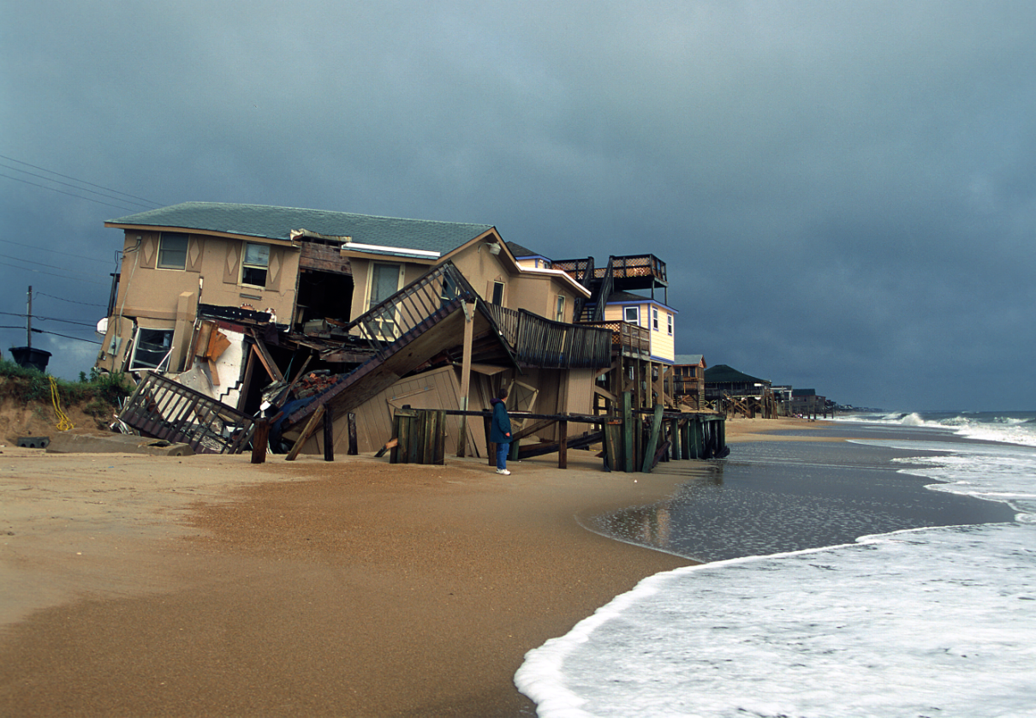
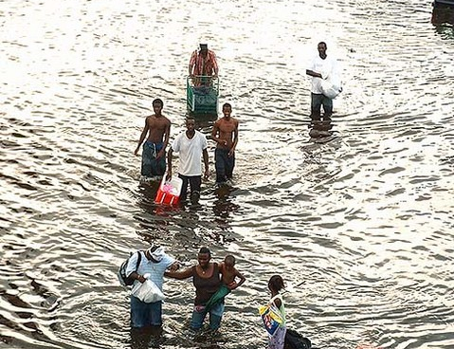
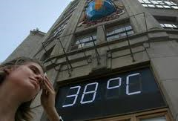
Climate and society are co-evolving in a manner that could place already vulnerable people and communities at a greater risk to weather-related disasters
Disaster Risk Reduction
Climate Change Adaptation

Slide 3
Understanding Risk to Weather Disasters
Hazard Vulnerability Risk
Floods
Droughts
Extreme Heat Events
Exposure
Sensitivity
Adaptive Capacity
Loss of life and property
Health outcomes
Livelihoods

Slide 4
Considerations…
Understanding risk:
Knowledge about weather and climate, natural and built environments, demographic characteristics, and social and behavioral processes
Considerations of the dynamic nature of vulnerability
Reducing risk:
Stakeholder engagement at all levels
Flexible adaptive strategies
Tools for decision-making

Slide 5
Two examples
Extreme heat in Texas
NASA-funded multi-year study
Flooding in Colorado
Pilot project after 2013 flood

Slide 6
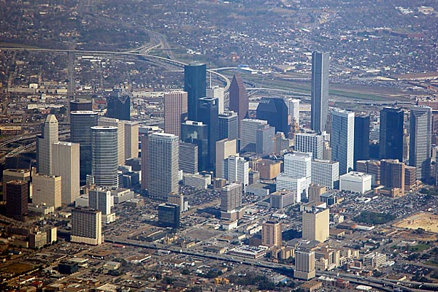
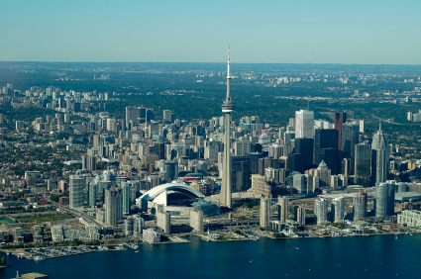
System for Integrated Modeling of Metropolitan Extreme Heat Risk (SIMMER)
Funding: NASA (09-IDS09-34) 2010-2014
Advance methodology for assessing current and future urban vulnerability from heat waves
Develop a system (SIMMER) for building local capacity for heat hazard mitigation and climate change adaptation in the public health sector
Geographic focus:
Regional scale: USA and southern Canada
Local scale: Houston, TX and Toronto, Canada

Slide 7
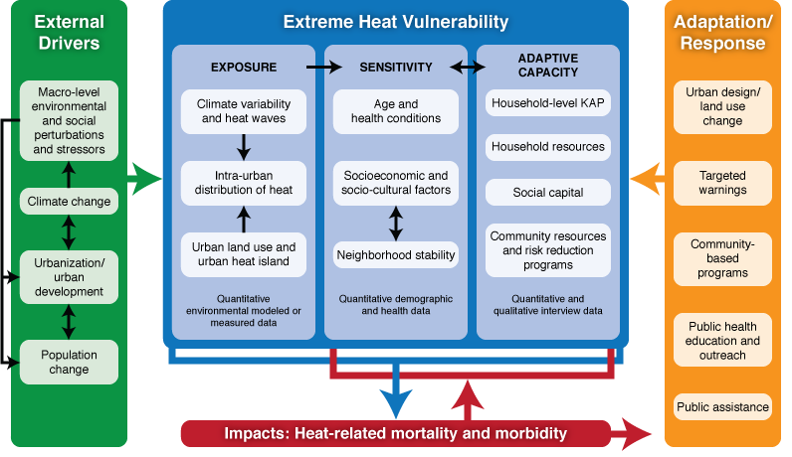
Conceptualizing Extreme Heat Risk
Wilhelmi and Hayden (2010)

Slide 8
Methods
GIS and remote sensing methods
Numerical weather and climate modeling
Bayesian statistical hierarchical modeling
Quantitative and qualitative social science methods
GIS web-based technology

Slide 9
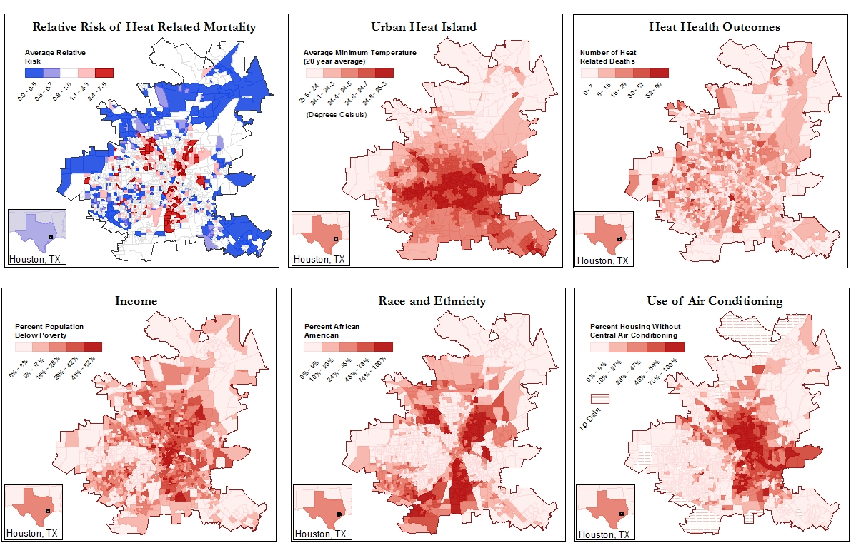
Mapping and Modeling extreme Heat risk

Slide 10
Exposure
Urban morphology, vegetation, and building materials play a major role in determining urban heat island (UHI) characteristics (Monaghan et al. 2014)
Relative risk of heat-related mortality in Houston has associations with high daily minimum temperature (Heaton et al. 2014, 2015)
Mid-century global climate model projections: more than half of summer nights qualify as high heat stress (Oleson et al. 2013)
https://gis.ucar.edu/heatinspector

Slide 11
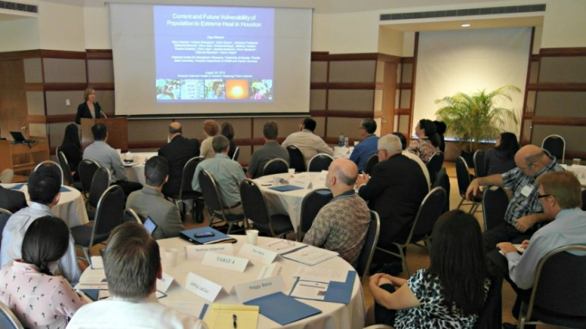
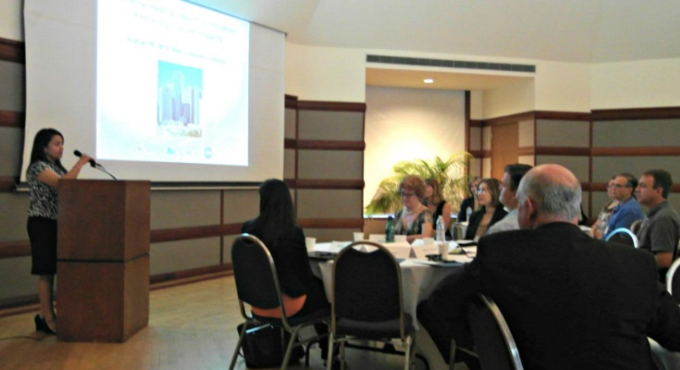
Adaptive capacity
Household survey (n=901, 2011)
Multiple social and behavioral factors interact to compound vulnerability, including lack of social capital. Presence of A/C does not always protect from heat. Most vulnerable populations also have little or no knowledge of the symptoms of heat stress, nor do they know about cooling centers. (Hayden et al. forthcoming)
Stakeholder survey (n=33, 2012) and workshop (2012)
Increasing risk to extreme heat due to growing number of vulnerable population (changing societal context)
Risk reduction efforts should be put towards extreme heat preparedness and response (i.e., risk communication, effectiveness of cooling centers, coordination and collaboration, thresholds and heat advisories)

Slide 12
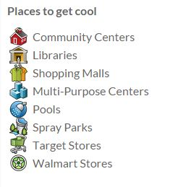
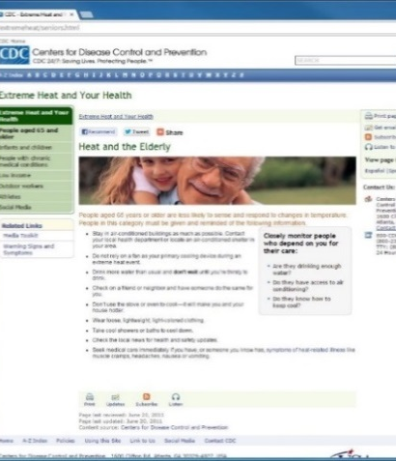
“Beat the Heat in Houston” – Online GIS application
http://gis.ucar.edu/projects/simmer

Slide 13
Colorado Front Range Floods of 2013
What does surprise teach us about vulnerability in high adaptive capacity systems?
Lisa Dilling^{1,2,3,4}, Rebecca Morss,⁵ and Olga Wilhelmi⁵
¹Western Water Assessment, ²Center for Science and and Technology Policy Research, ³Environmental Studies, ⁴University of Colorado Boulder,
⁵National Center for Atmospheric Research

Slide 14
Methods
Household survey (n=101)
Boulder, Lyons, Longmont, Estes Park
Administered by the Natural Hazards Center (Welton-Mitchell, James, and Perez Foster)
Questions:
Were you surprised by anything about the September 2013 Colorado Flood?
What surprised you?

Slide 15
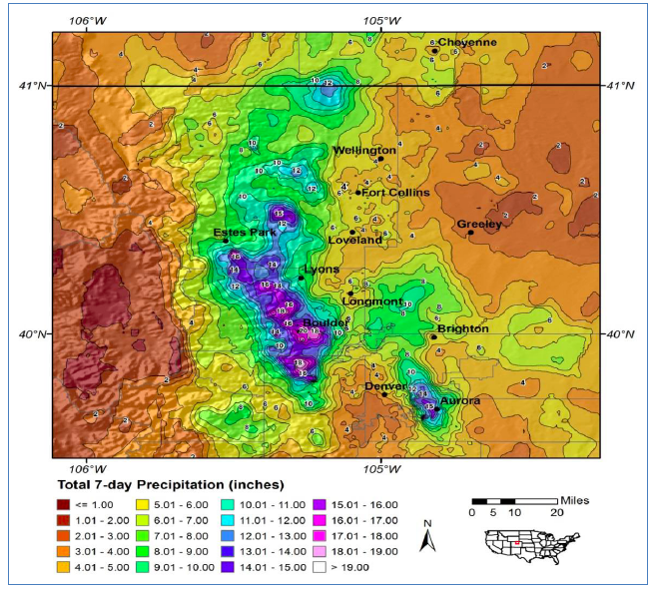
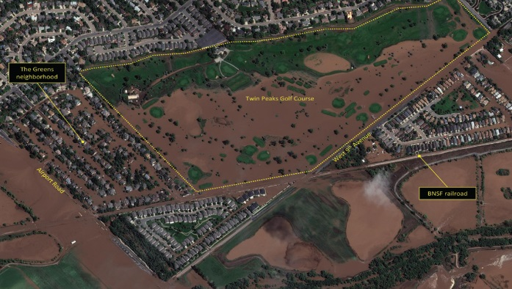
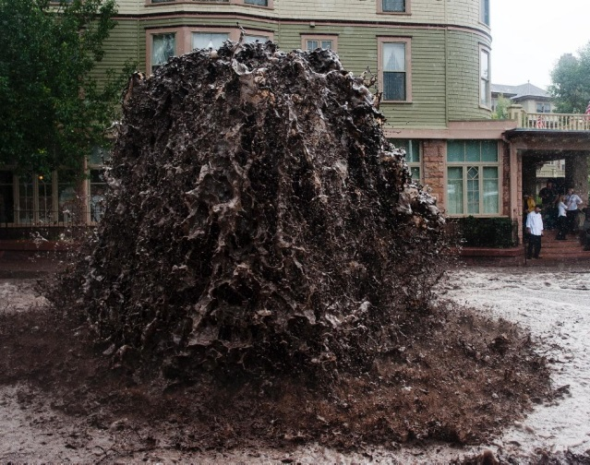
Exposure
Amount of rain
“I have lived in Boulder County for over 30 years and have never seen anything close to this type of rainfall.”
Extent of flooding
Location of flooding
“I thought Boulder flooding would be focused near the downtown area and Pearl Street, but it seemed to be much more damaging to residential areas of town.”
Source of flooding
Duration of flooding
“How long the water kept streaming across our lands - for 10-14 days after the flood.”

Slide 16
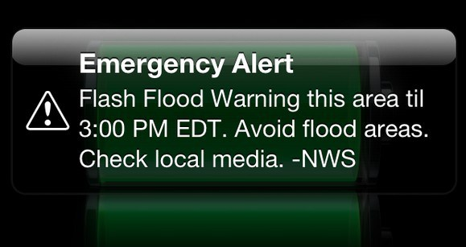
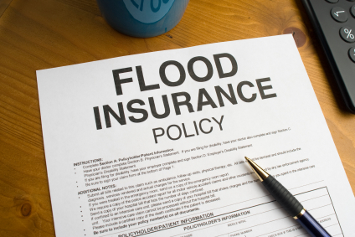
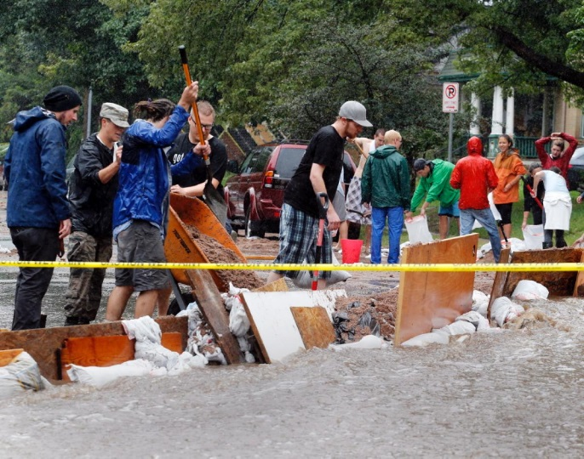
Adaptive Capacity
Warning and information
“We are not in a flood plain & it was barely raining. There was NO warning.”
Insurance limits
Positive: community support
Positive: Rapid response of officials and construction crews
Transportation challenges

Slide 17
Lessons learned
Lack of awareness of the full dimensions of flooding
Information products (e.g. flood maps) and warnings still do not seem sufficient, can even give false sense of security – how do we acknowledge uncertainty and true risks?
Community relationships, ingenuity, and cooperation a powerful form of adaptive capacity
Infrastructure, especially transportation, a critical foundation for adaptive capacity, key vulnerability cascades revealed

Slide 18
Summary
Extreme weather events, interacting with vulnerable social and ecological systems, can lead to disasters.
Understanding and characterizing risk and vulnerability at the scales of decision-making can lead to more effective hazard mitigation (extreme heat example).
Critical component in climate adaptation is understanding population adaptive capacity at the local level.
Even in a high adaptive capacity context, “surprising” vulnerabilities exist. Opportunity to learn from these “surprises”.
Understanding the dynamics of vulnerability (changing exposure, sensitivity and adaptive capacity) is important for understanding and reducing risk to weather disasters.

Slide 19
Thank you!
Contact:
olgaw@ucar.edu

