Slide 1
WHAT RISKS?
A sample set of risk assessments from across the region and how to use them
Wednesday, November 18, 2015
African Union – Addis Ababa, Ethiopia

Slide 2
Global Risk Model
Preliminary National Risk Profiles for African Countries
JULIO SERJE
UNISDR

Slide 3

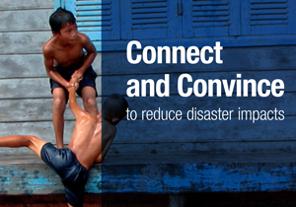
UNISDR mission
Coordinate
Advocate
Monitor Sendai FDRR
Generate knowledge
Inform community
UNISDR is the custodian of the Hyogo and Sendai Frameworks for Disaster Risk Reduction and one of its mandates is to support countries on its implementation
Notes:
3

Slide 4

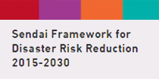





Some of UNISDR activities and products:
Notes:
4

Slide 5
Sendai Framework for Disaster Risk Reduction 2015-2030
Four priorities for action
Increase Risk Knowledge
Improve Risk Governance
Invest in DRR for Resilience
Prepare for response and build back better

Slide 6
Sendai Framework for Disaster Risk Reduction 2015-2030
Seven global targets
Reduce Mortality
Reduce Affected People
Reduce Direct Economic Loss
Reduce Damage to Critical Infrastructure and Disruption of Basic Services
Increase the Number of Countries with National and Local DRR Strategies
Enhance International Cooperation
Increase the Availability and Access to Early Warning Systems and Disaster Risk Information and Assessments

Slide 7
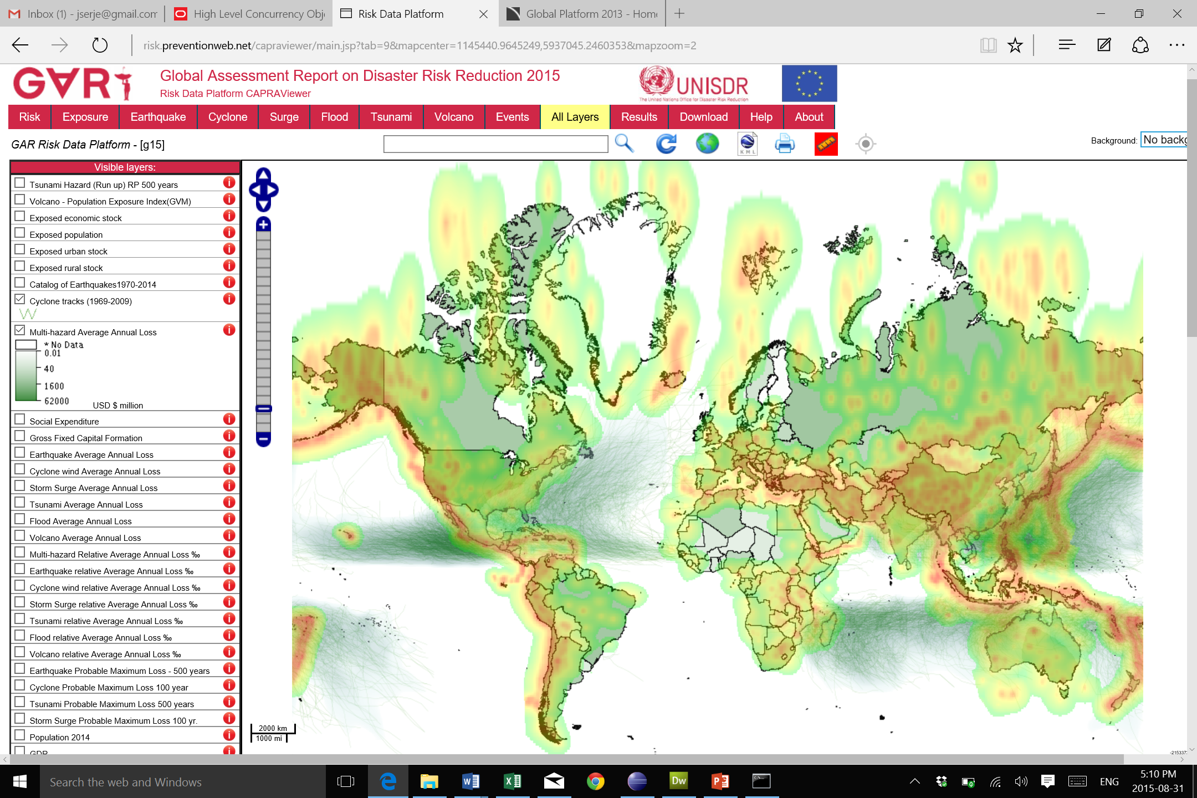
Global Probabilistic Risk Assessment
http://risk.preventionweb.net/
Notes:
7

Slide 8
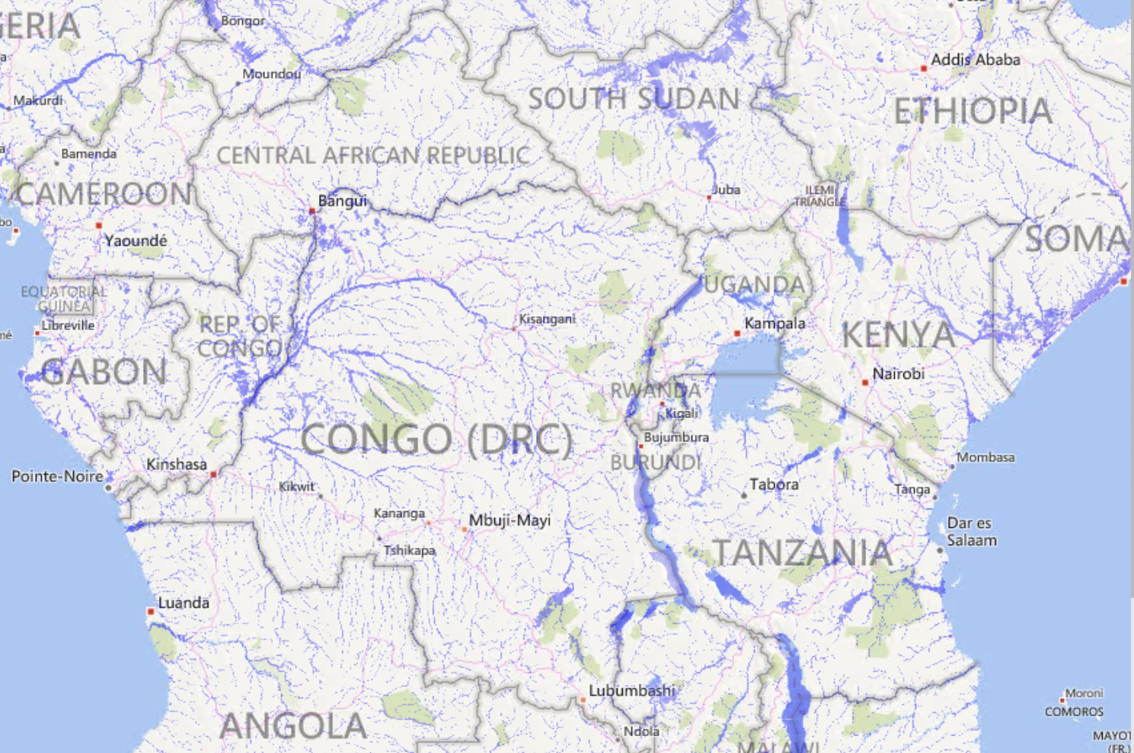

Flood Hazard Model:
Flood model: 6 hazard return periods - 1Km grid (original at 90 mts resolution)
Notes:
8

Slide 9
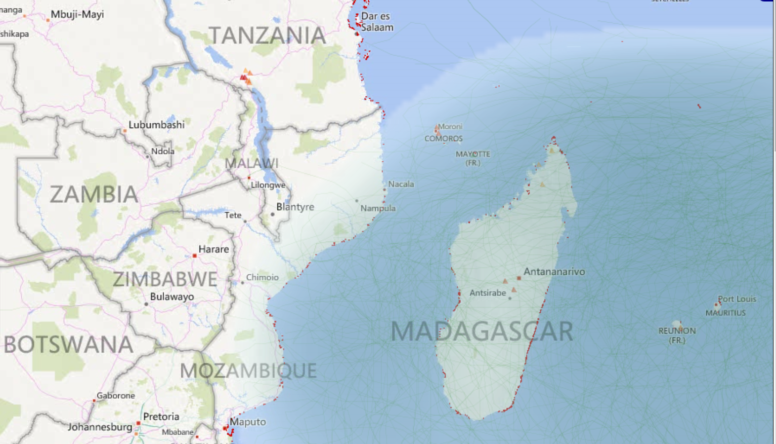
Cyclone Wind Hazard Model Tsunami Hazard Model
6 hazard return periods - 5Km grid 500 mts runup
Notes:
9

Slide 10
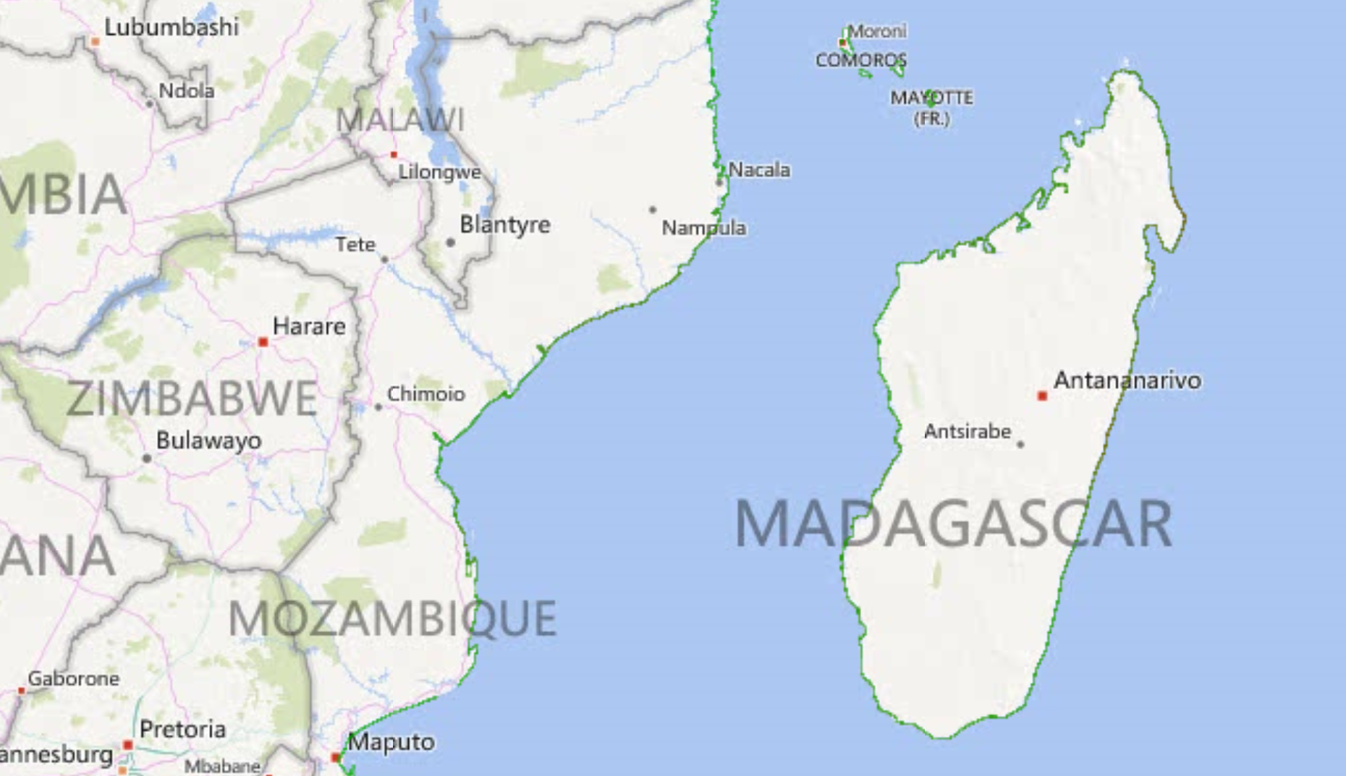
Cyclone Storm Surge Hazard Model
6 hazard return periods - 1Km grid
Notes:
10

Slide 11
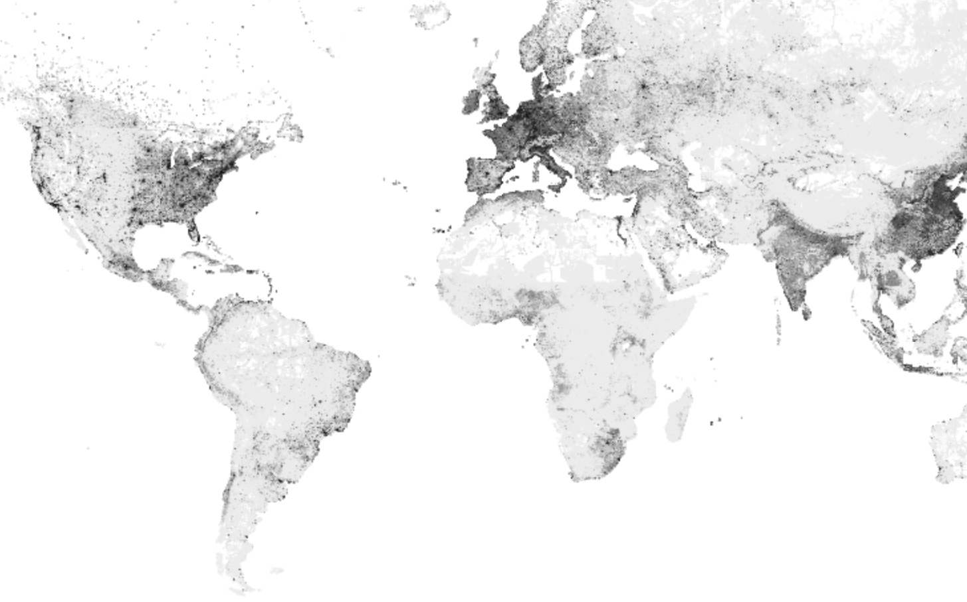

Risk components - Exposure
5x5km Grid with global coverage, 1x1 km grid for selected coastal areas
Urban + rural economic stock (million USD)
5x5 grid: 4.9 million cells
Notes:
11

Slide 12
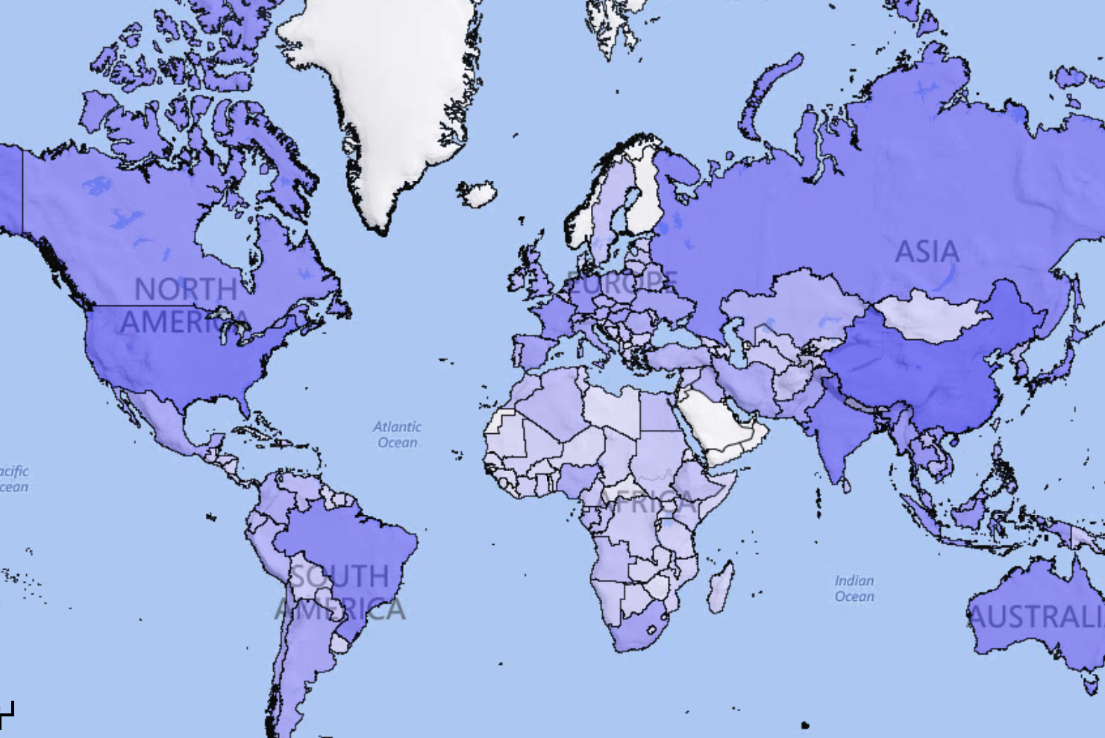

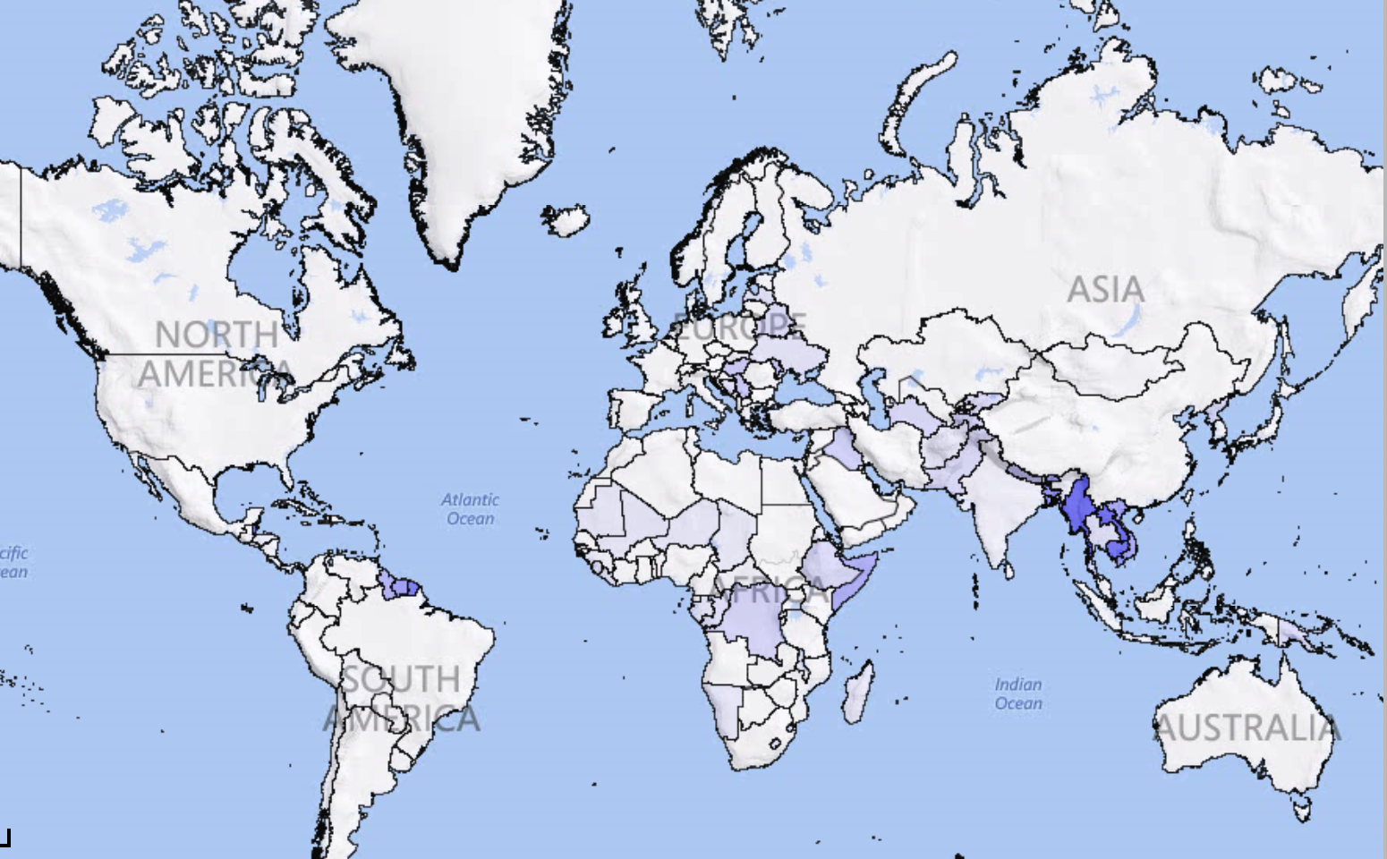

Risk metrics at country (province level soon)
AAL’s and PML’s - Absolute and Relative for 5 major hazards
Flood AAL- Relative
Flood AAL- Absolute
Notes:
12

Slide 13
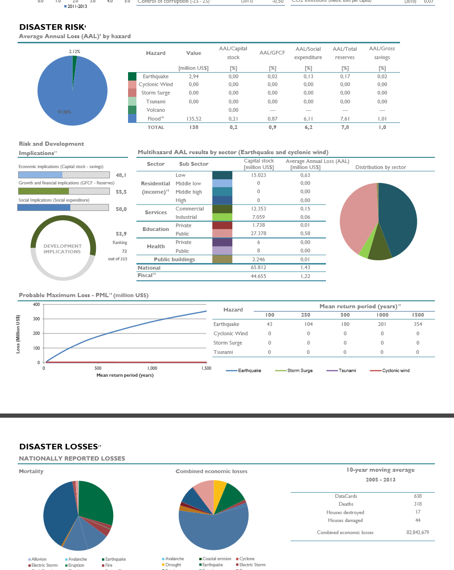
Preliminary National Risk Profiles
Available for ALL African countries
http://www.preventionweb.net/gar
Notes:
13

Slide 14

Thank you
Julio Serje
serje@un.org
Senior Program Manager
United Nations Office for Disaster Risk Reduction
Geneva, Switzerland
Notes:
14

Slide 15
www.understandrisk.org/URfinance
#URfAfrica

Slide 16
Unveiling Earthquake Risk in Africa
VITOR SILVA
Global Earthquake Model Foundation

Slide 18
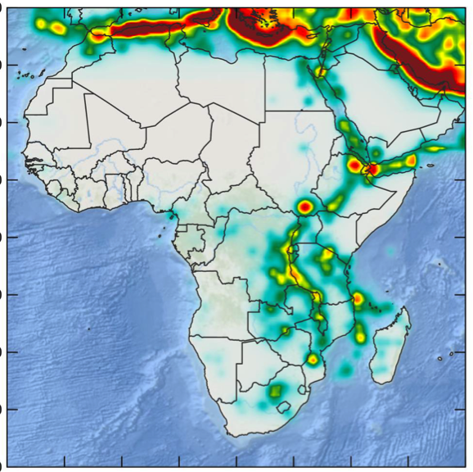
SSAHARA Project – GEM + USAID
Sub-Saharan Hazard and Risk Assessment
The project covers Ethiopia, Kenya, Ghana, Rwanda, Uganda, Burundi, Tanzania, Malawi and Ghana.
In the last century, more than 80 destructive earthquakes have occurred, causing approximately 21,000 fatalities, almost a 1,000,000 homeless and economic losses that exceeded 12 billion USD.
What (earthquake) risks?

Slide 19
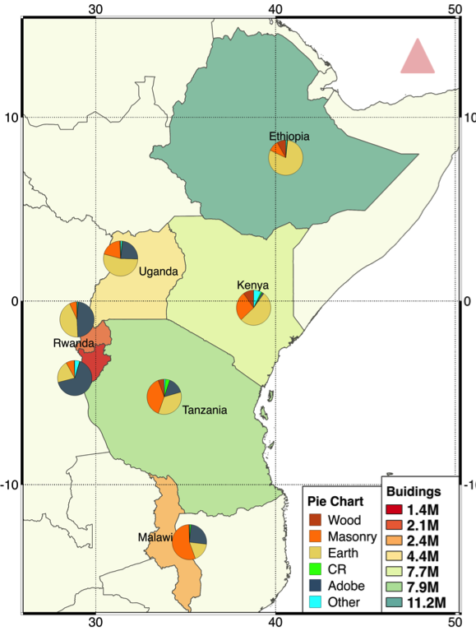
SSAHARA – Outputs
A wide spectrum of outputs to support decision-making.
Seismic Hazard Maps
Exposure Datasets
Physical Vulnerability
Social and Economic Vulnerability
City Scenarios
Earthquake Risk Profiles
Capacity Building/Training

Slide 20
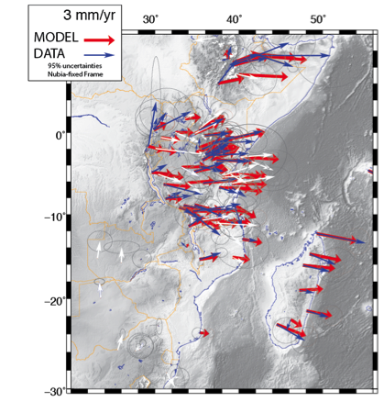
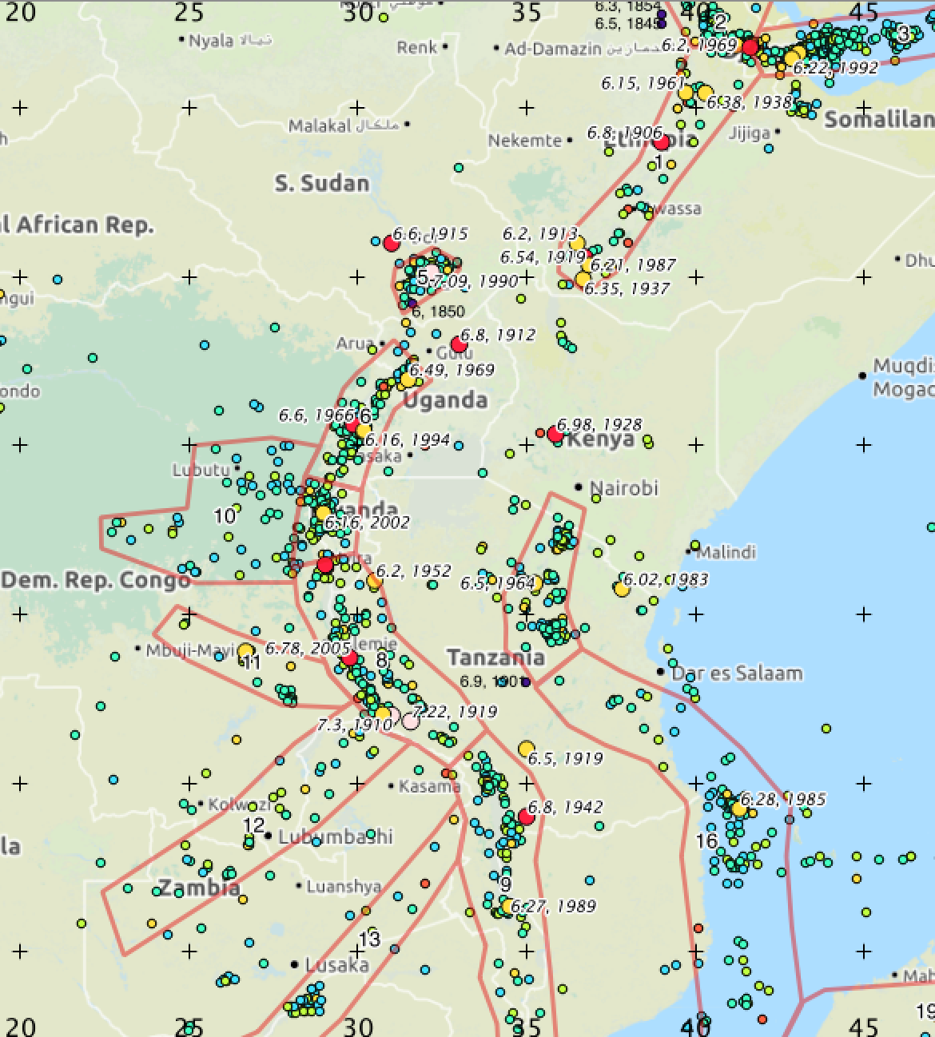
SSAHARA – Seismic Hazard
Collaboration between Africa Array and GEM.
New strain rate model
First model based on area sources, integration of faults and tectonic strain in progress.

Slide 21
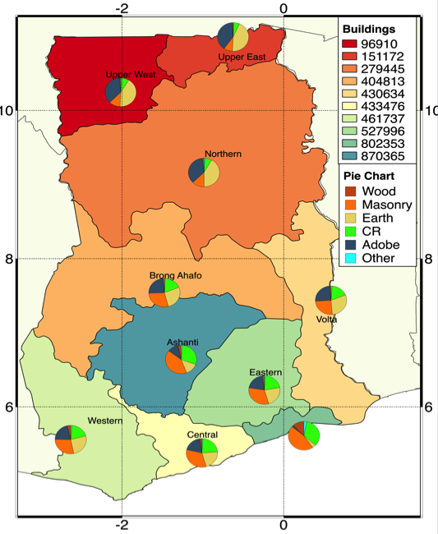
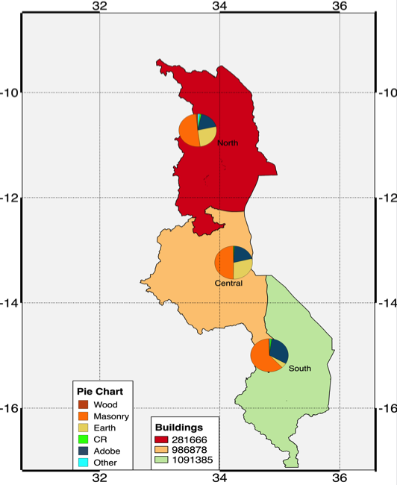
SSAHARA – Exposure
Data regarding the built-up environment (buildings).
Exposure data for Ghana
Exposure data for Malawi

Slide 22
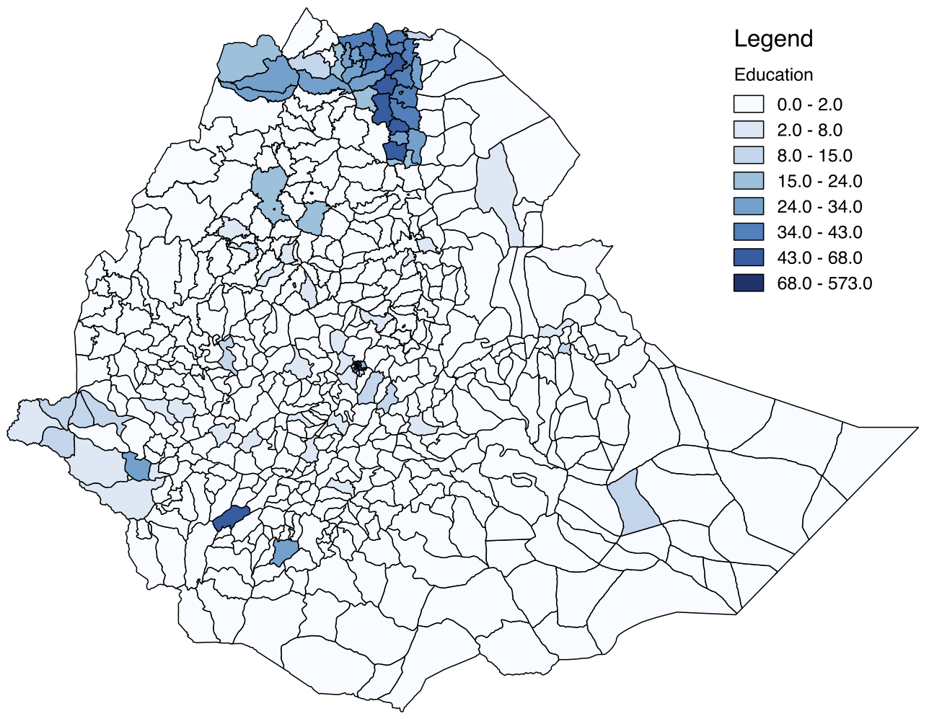
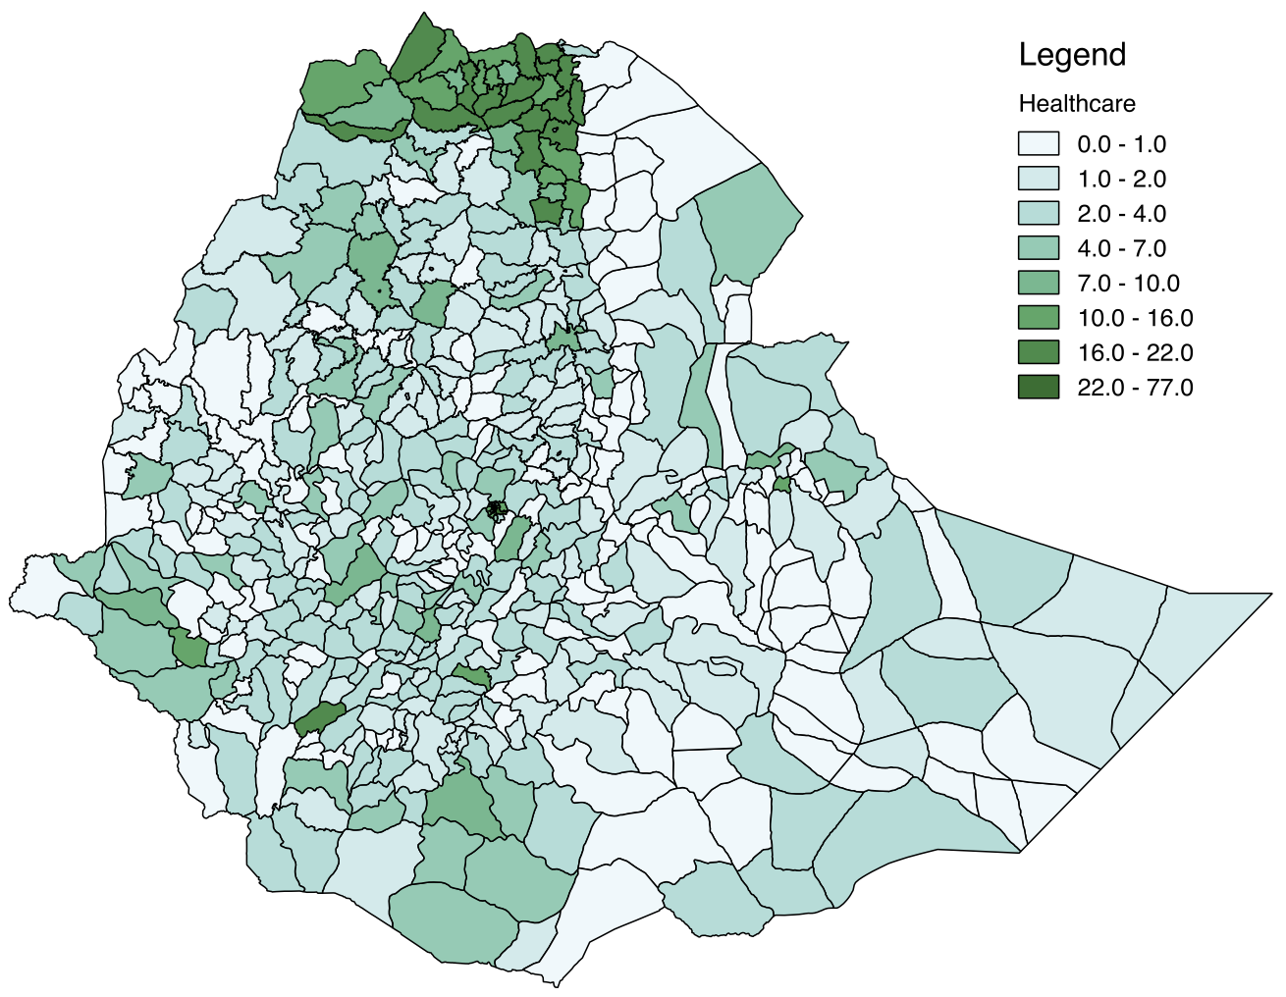

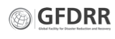
SSAHARA – Exposure
Data regarding infrastructure produced by ImageCAT and GFDRR
Educational infrastructure
Healthcare facilities
Data produced by:

Slide 23
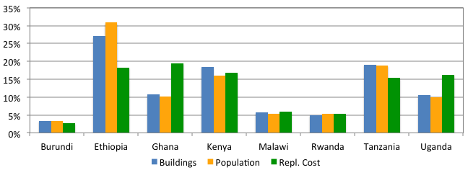
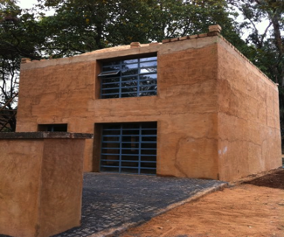
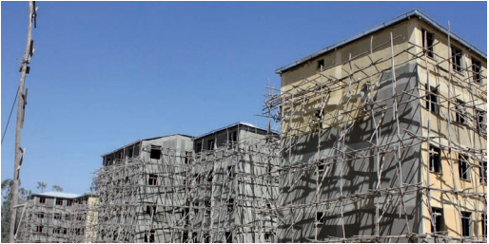
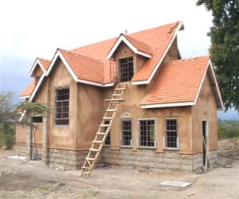
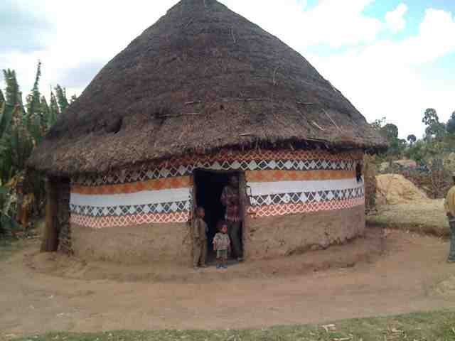
SSAHARA – Physical Vulnerability
Models to predict the likelihood of buildings to suffer damage

Slide 24
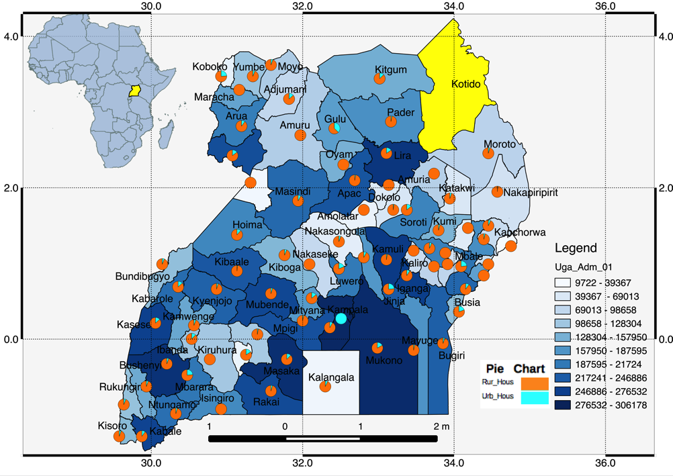
SSAHARA – Socio-eco. Vulnerability
Consideration of the socio-economic aspects in the risk analyses.
Urban and rural population for Uganda.

Slide 25
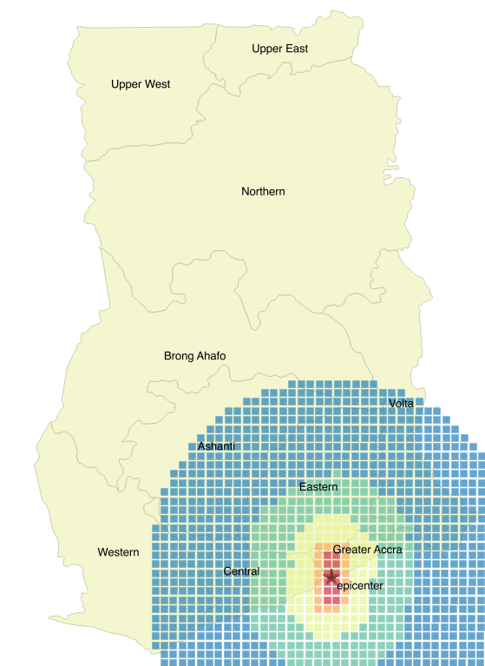
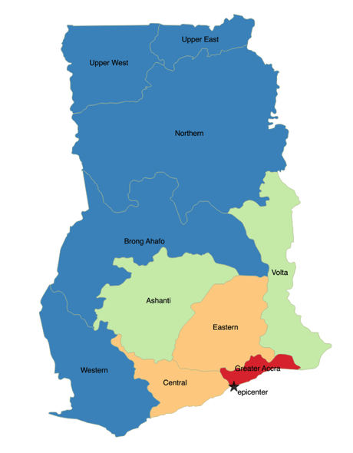
SSAHARA – City Scenarios
Evaluation of the adverse consequences of earthquakes.
Simulation of an earthquake south of Accra: seismic intensity (left) and distribution of damage (right).

Slide 26
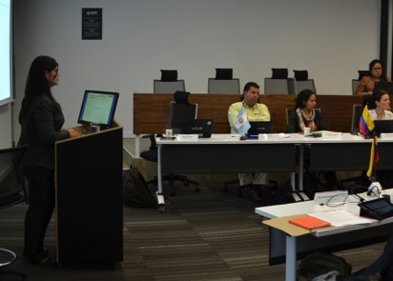
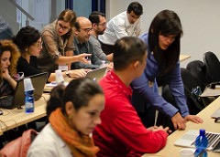
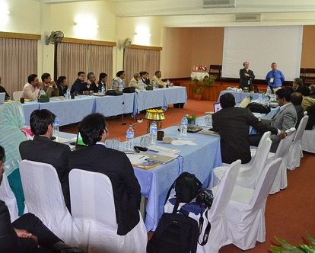
SSAHARA – Capacity building
41 countries have been involved in training in seismic risk assessment.

Slide 27
SSAHARA – Challenges
Lack of data regarding the built-up environment;
Lack of physical vulnerability models;
Reduced earthquake risk awareness;
Limited capacity for earthquake risk analysis.

Slide 28
Sendai Framework for Disaster Risk Reduction
Earthquake Risk Profile - Italy
Seismic hazard
Seismic risk
Social vulnerability
Integrated risk
Demonstrative example for Italy
Social indicators
Risk indicators
Regions highest risk
Population (million):
GDP (billion USD):
Capital stock (billion USD):
Life expectancy:
GINI Index:
Gross savings (billion USD):
58.83
2071
8604
82.9
36.0
383.0
Population at risk (million):
Property at risk (billion USD):
AAL (economic - billion USD):
AAL (fatalities):
Max. economic loss (billion USD):
Probable max. loss (billion USD):
25.8
777.2
2.87
401
63.2
17.5
Financial indicators
Sector | Return period (years)
 | 100 | 500 | 1000 | 2500
Residential | 1.3E+10 | 2.4E+10 | 2.9E+10 | 3.9E+10
Services | 1.1E+09 | 2.0E+09 | 2.4E+09 | 3.3E+09
Health | 3.2E+07 | 5.9E+07 | 6.9E+07 | 9.1E+07
Educational | 1.8E+08 | 3.2E+08 | 4.5E+08 | 6.7E+08

Slide 29
www.understandrisk.org/URfinance
#URfAfrica
Unveiling Earthquake Risk in Africa: from Rupture to Recovery
University of Addis Ababa (room 215)
20th of November (Friday) from 14:00 to 17:00

Slide 30
South West Indian Ocean
Risk Assessment and Financing Initiative
SWIO-RAFI
KRESH SEEBUNDHUN
Lead Analyst, Ministry of Finance, Mauritius

Slide 31
SUMMARY (1)
Introduction
Complementary to UNISDR work for Indian Ocean Commission (IOC) to build resilience of small islands states.
Aligns with Mauritius Strategy for Further Implementation of the Program of Action for Sustainable Development of Small Island Developing States (SIDS) 2005-2015.
Financially supported by EU in framework of ACP-EU Natural Disaster Risk Reduction Program, managed by the GFDRR.
Geographic Scale
Detailed risk profiling for 4 countries within the IOC- Comoros, Madagascar, Mauritius and Seychelles plus Zanzibar
Timescale
3 Years (commenced April 2014)
Hazards
Tropical cyclones, torrential rains, flash floods and earthquakes.

Slide 32
SUMMARY (2)
Coverage
Identification of potential disaster losses from a budgetary perspective (fiscal disaster risk analysis);
Inventory of existing financing available in each country for disaster response and recovery; identify gaps, evaluate other national options
Develop preliminary disaster risk financing strategies for each country
Assess feasibility of regional risk financing

Slide 33
OUTPUT (1)
For each of the 5 island states
  Risk profiles: total economic loss and direct public loss for emergency response, recovery, and reconstruction of public assets
  Event-loss tables for further risk financing analysis
  GIS hazard layers
  Nationally appropriate replacement values and construction costs
  National catastrophe risk financing options and strategies (develop and make operational in phase 2)
Region Wise
  Establishment of a regional open data platform
  Assessment of potential regional risk financing solutions (similar to Caribbean and Pacific, development of solutions in phase 2)

Slide 34
OUTPUT (2)
Quantification of Economic Loss
~ Estimated USD 59 M over the period 1980-2013 for Mauritius-
with tropical cyclone accounting for 82%
~ Over a 50 year return period
Average Annual Loss - AAL - USD 87 M
Probable Maximum Loss - PML - USD 1,094 M
Risk Sensitive Budget Review (Mauritius using DRM Marker)
~ around 10% Recurrent and 15% of Capital Budget devoted to DRR (2013)
Template or decision making
~ 5 Steps Streamlined Process for making in DRR Investment

Slide 35
CHALLENGES (1)
Challenges encountered
Lack of reliable disaster data/ information
Limited data concerned only physical loss and spread among various institutions
Technical staff not trained on analysis and costing of loss data, risk analysis and risk assessment
How were these overcome?
Central coordinating body
Data sharing among institutions facilitated
Training on usage of DRM Tools (CATSIM, DESInventar, Probabilistic Cost Benefit Analysis, DRM Marker for Risk Sensitive Budget Review etc.)

Slide 36
CHALLENGES (2)
What Challenges remain ? (Financial)
Limited resources and competing needs i.e. Investment in DRR v/s investment in education, public health and social protection.
How much money should be allocated to DRM in total?
How to decide on the most efficient and effective allocation of money between risk reduction and risk financing?
Level of Risk Retention v/s Risk Transfer - how to evaluate and select risk financing options
What challenges remain? (Non-Financial)
Continuous capacity building and transfer of technical know-how
Improvements in data collection and data sharing (national and regional)
Clear definition of role and responsibilities, stronger collaboration between institutions involved in DRM: Ministry of Finance, DRM Agency, other key sectoral ministries
National and regional sustainability of the project

Slide 37
BENEFITS
At National Level
Better information on impact of climatic and natural disaster - both direct physical losses and indirect economic loss
Future investment in DRR based on evidence
Sound basis for implementation of disaster risk financing - improves understanding of disaster risks and financing solutions for small island states.
Risk profiles enable better decisions on Risk Retention v/s Risk Transfer
Institutional capacity building
At Regional Level
Sharing of experiences and know-how
Regional pooling of risks

Slide 38
THANK YOU

Slide 39
www.understandrisk.org/URfinance
#URfAfrica

Slide 40
National Risk Atlas of Rwanda
ERASME NTAZINDA
Ministry of Disaster Management and Refugee Affairs, Rwanda

Slide 41
Summary
Country wide
18 months
5 Hazards of concern:
  Droughts
  Floods
  Landslides
  Earthquake
  windstorms
Outputs:
  Hazard maps
  Exposure
  Vulnerability
  Economic cost

Slide 42
Outputs: Exposed elements
Sector\ Hazard | Population | Building | Crop | Healthcare facilities | Education facilities | Transportation facilities
DROUGHT | X |  | X
EARTHQUAKE | X | X |  | X | X | X
FLOOD | X | X | X | X | X | X
LANDSLIDE | X | X | X | X | X | X
STORMS | X | X | X | X | X
Add pictures of historical disaster for these elements at risk

Slide 43
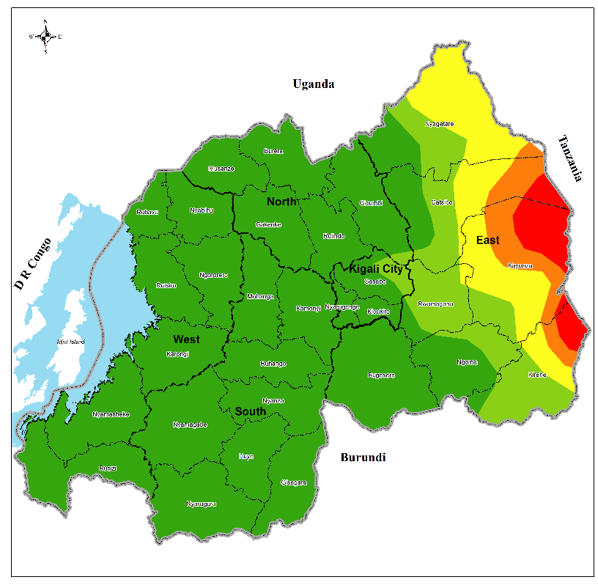
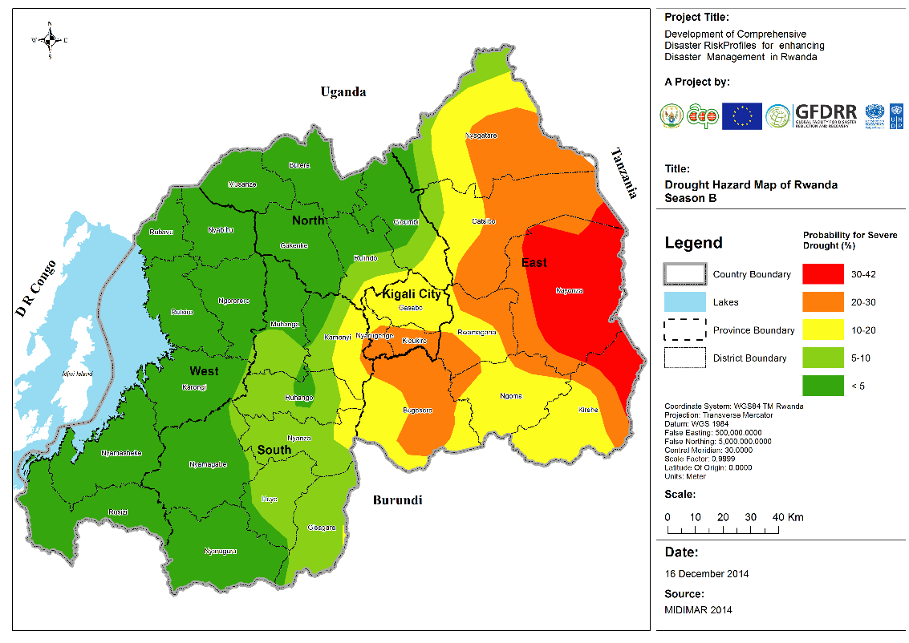
Outputs: Drought assessment
Season A
Population: 620,000 (4,5% vulnerable)
Crops (tons): 425,000 (12% vulnerable)
Season B
Population: 3,850,000 (4% vulnerable)
Crops (tons): 1,400,000 (13% vulnerable)

Slide 44
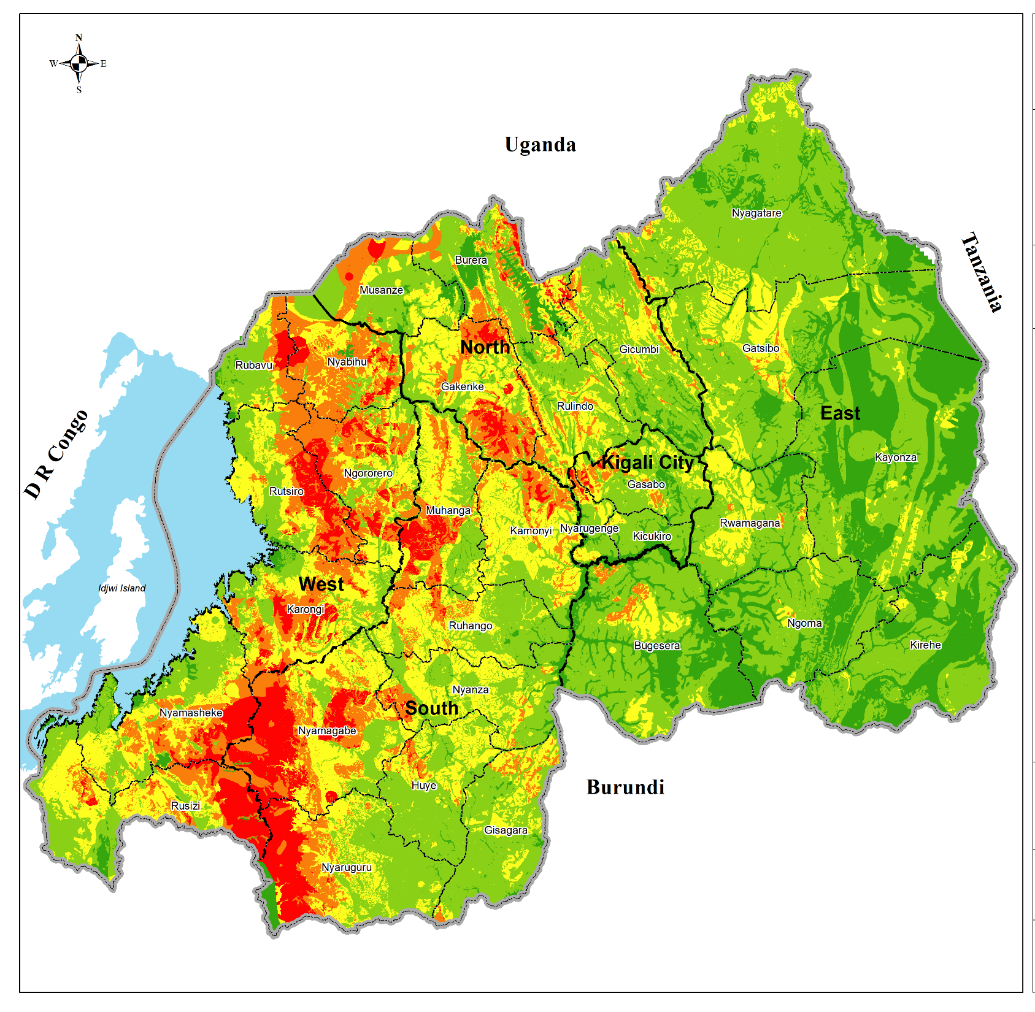
Outputs: Landslide assessment
ANALYZED ASSET | EXPOSED | VULNERABLE (% of exposed)
Population | 4,200,000 | 0.2
Houses | 950,000 | 3
Schools | 1,450 | 15
Health facilities | 60 | 25
National paved roads | 550 | 30
National unpaved roads | 690 | 30
District roads | 2000 | 30

Slide 45
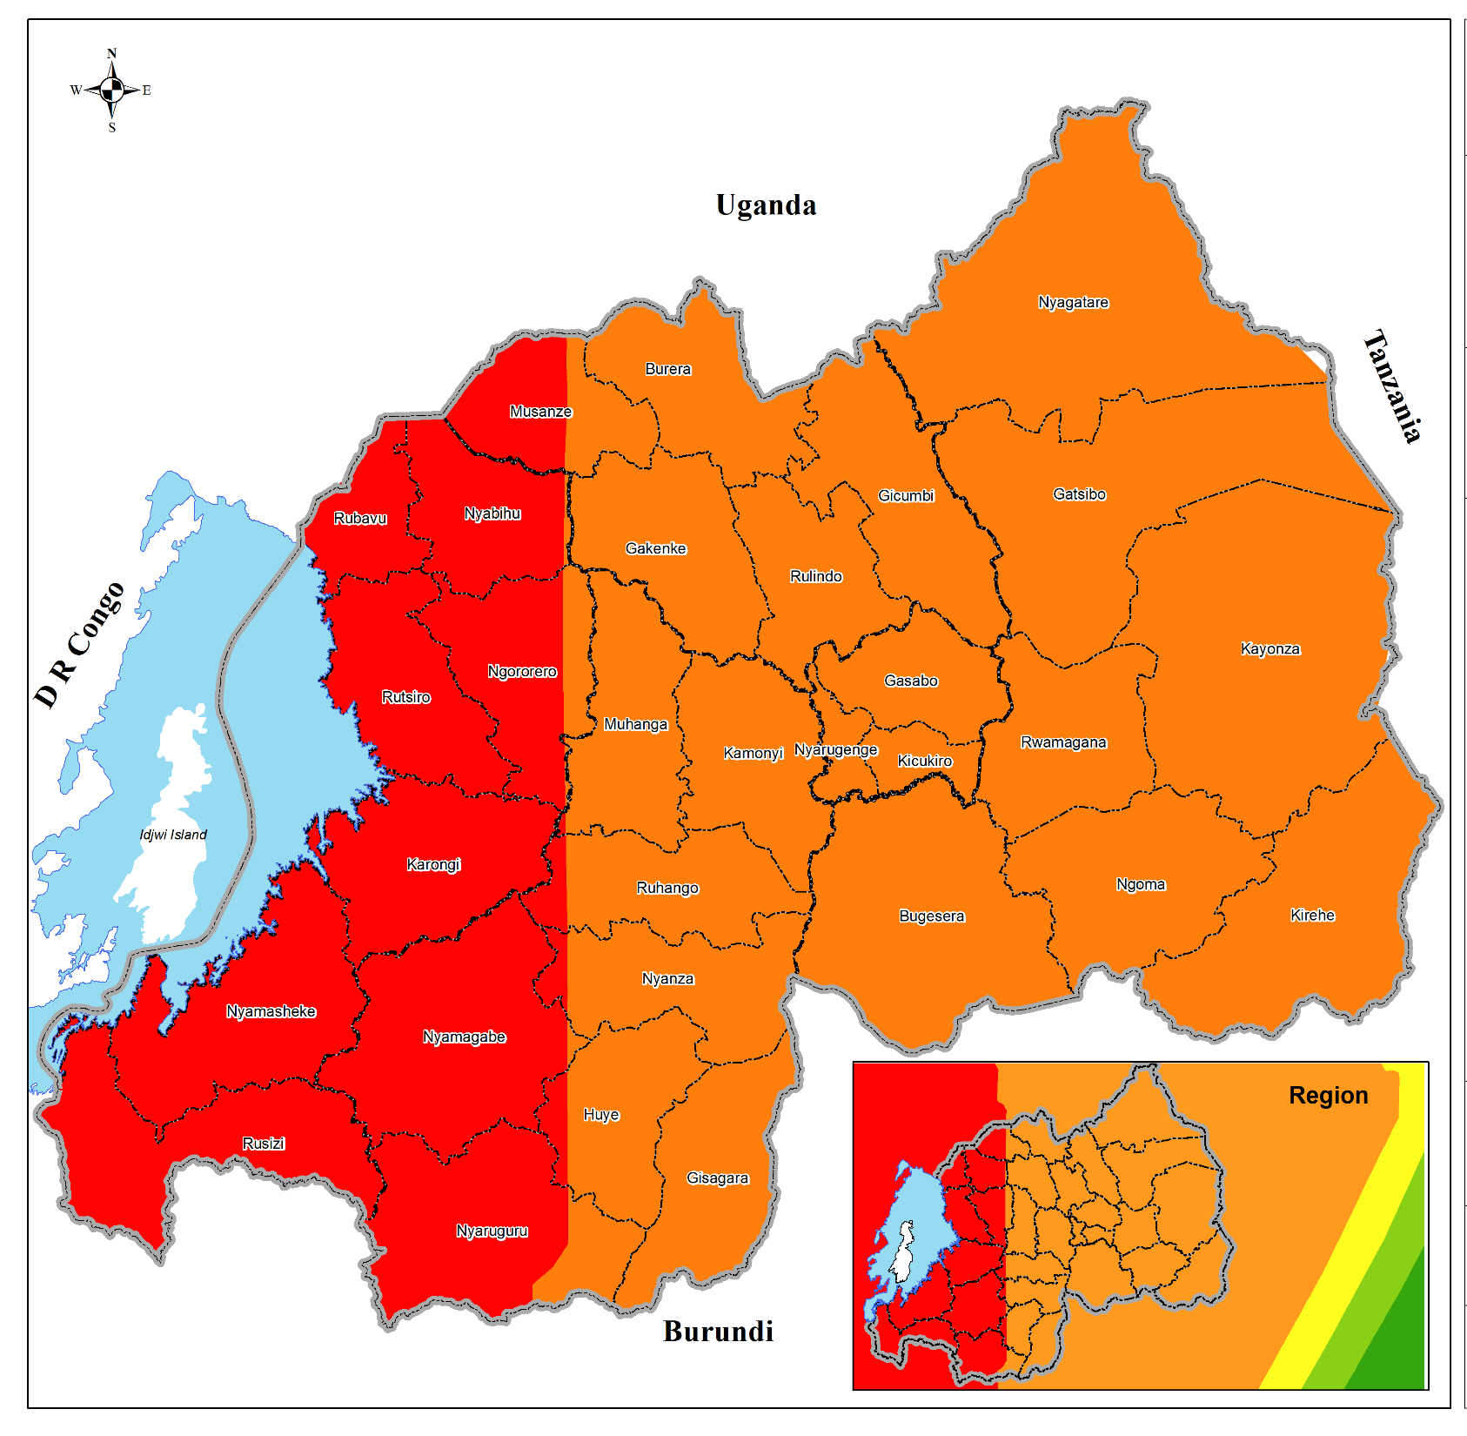
Outputs: Hazard maps (earthquake)
ANALYZED ASSET | EXPOSED | VULNERABLE (% of exposed)
Population | 3,000,000 | 0.2
Houses | 1,000,000 | 37
Schools | 1,000 | 30
Health facilities | 540 | 9

Slide 46
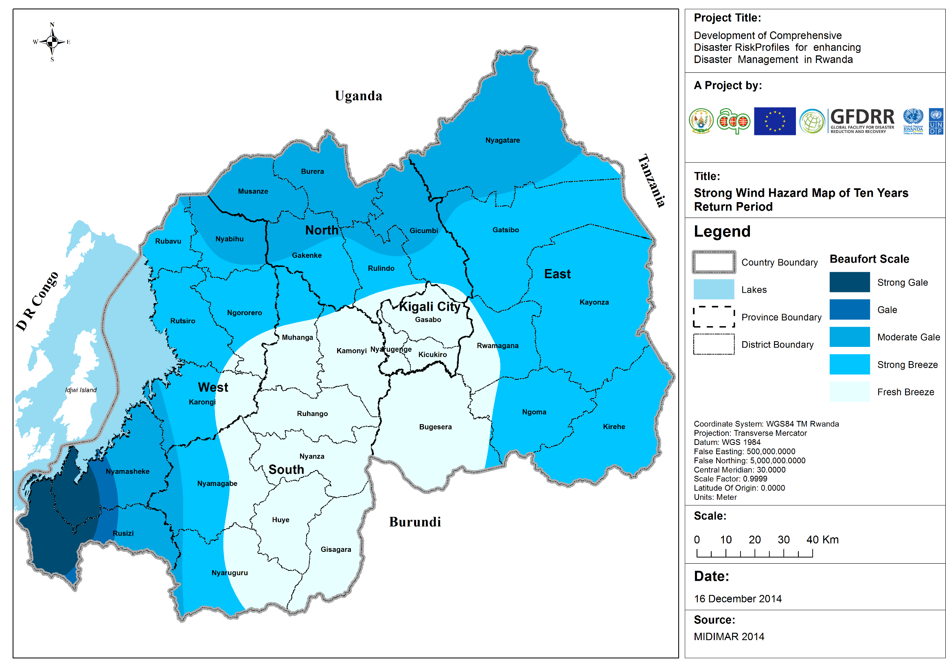
Outputs: Hazard maps (windstorms)
ANALYZED ASSET | EXPOSED | VULNERABLE (% of exposed)
Population | 2,800,000 | 0.17
Houses | 600,000 | 1

Slide 47
Challenges
Challenges encountered:
  Data
  Expertise
How were these overcome?
  Use proxy data
  Regional and international organizations
  International expertise
What challenges remain?
  Cost benefit analysis,
  Flood exposure/vulnerability analysis

Slide 48
Benefits
What benefits have come / are expected from the assessment?
  Done by local experts (capacity building)
  Better planning
  Useful by Critical Infrastructure Protection, Land use planning, food security and settlement programs

Slide 49
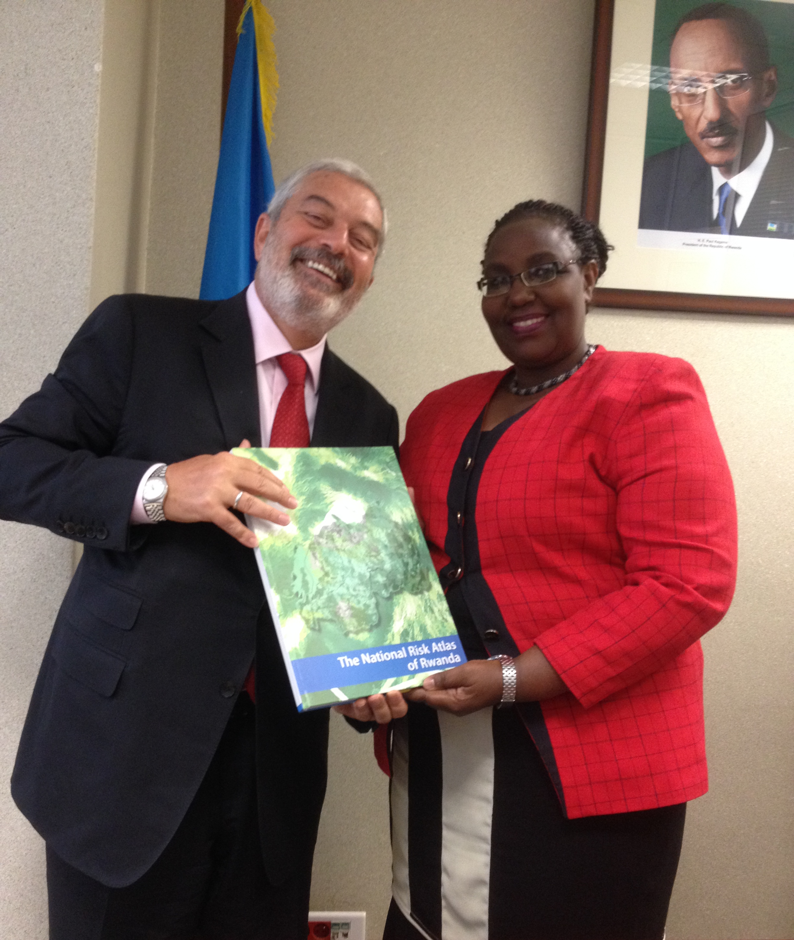
THANK YOU
www.understandrisk.org/URfinance
#URfAfrica
Photo: Honorable Minister of MIDIMAR with Mr. Magdy Soliman Martinez, UNDP’s Assistant Administrator and Director of the Bureau for Policy and Programme Support to launch the National Risk Atlas document

Slide 50
Landslide Risk Assessment, Bududa district – Uganda
Martin Owor
COMMISSIONER, RELIEF, DISASTER PREPAREDNESS AND MANAGEMENT
OFFICE OF THE PRIME MINISTER,
UGANDA

Slide 51
Summary
Geographical scale: District level; Bududa district
Time scale: One Month (July 2015)
Hazards: Landslides
Outputs:
Landslide susceptibility map
Community vulnerability profile
National El Nino Preparedness and Contingency Plan($9 million approved by Cabinet)

Slide 52
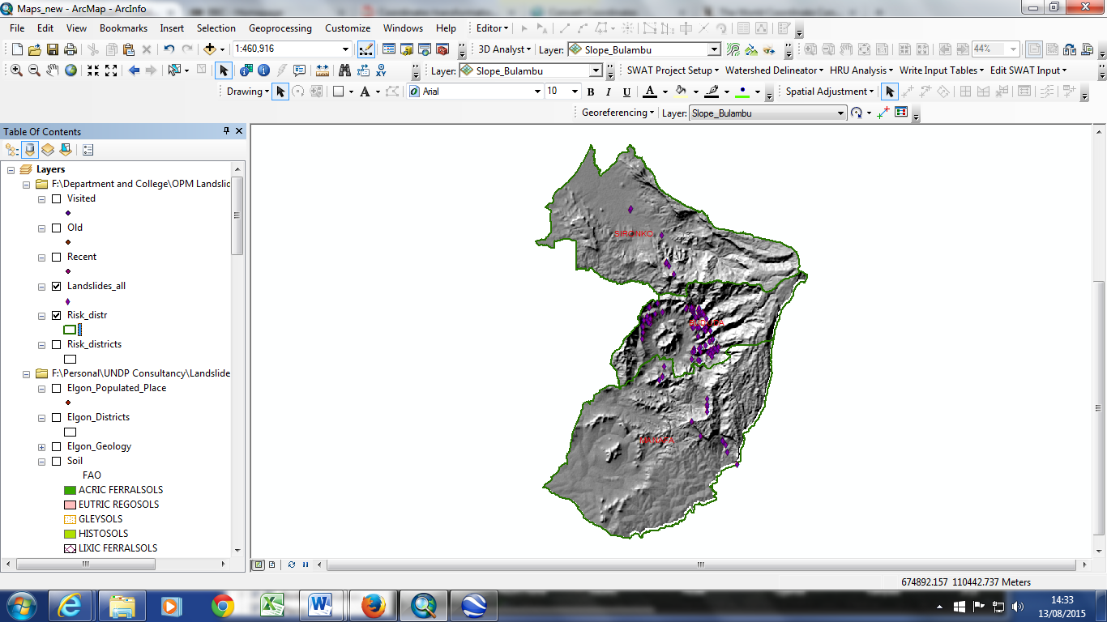
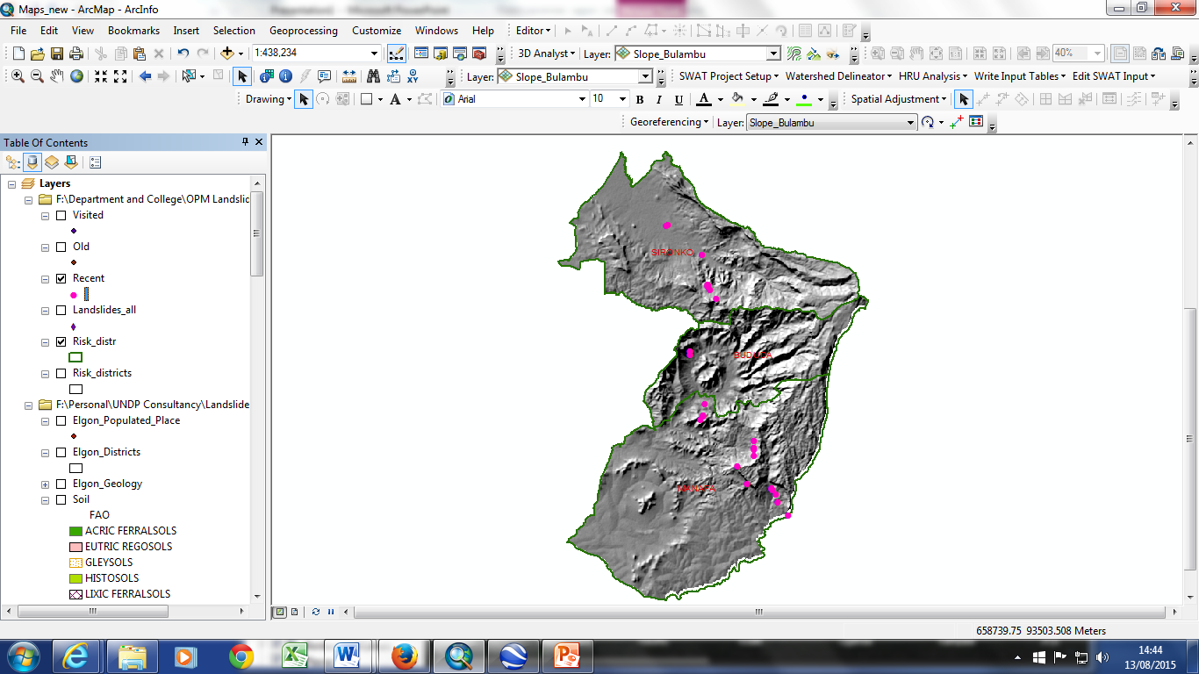
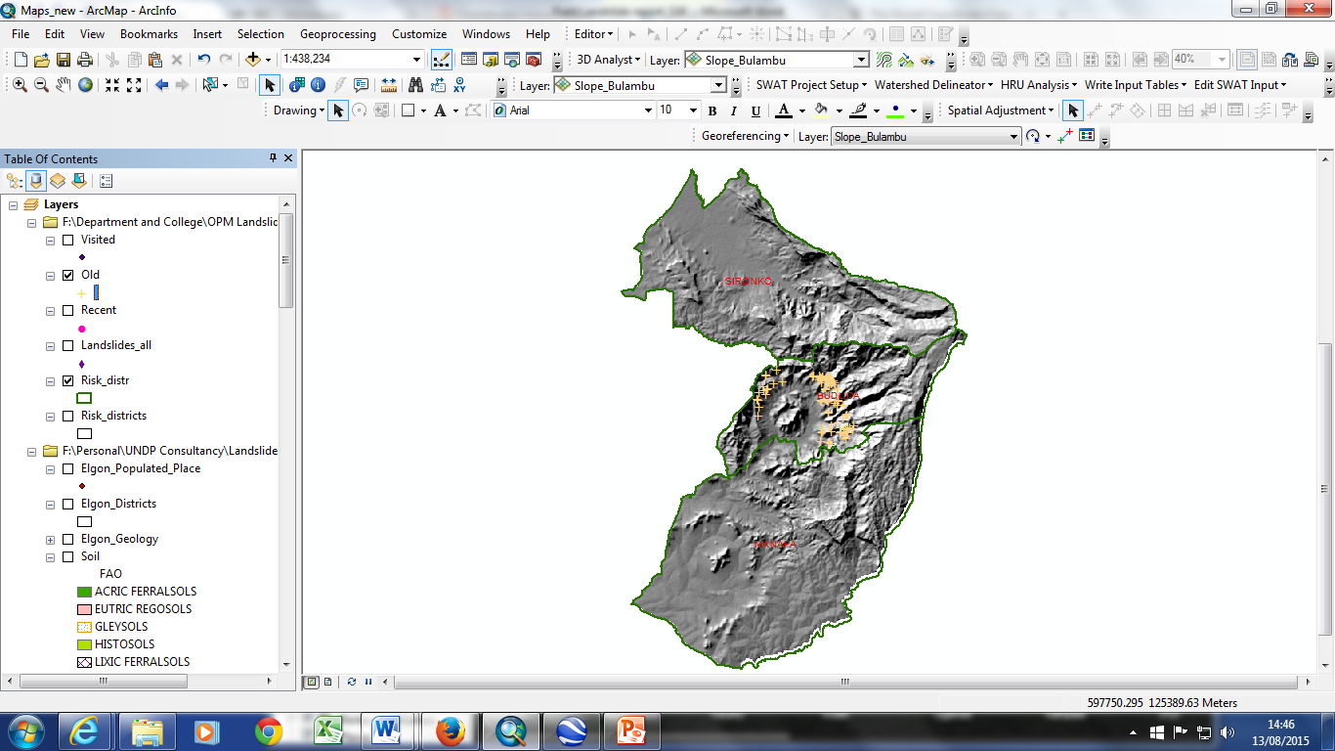
Landslide occurrence over a period of time
Output 1: a = Registered landslides, b= recent landslides and
c = landslide occurrence in the Elgon sub-region
a
b
c

Slide 53
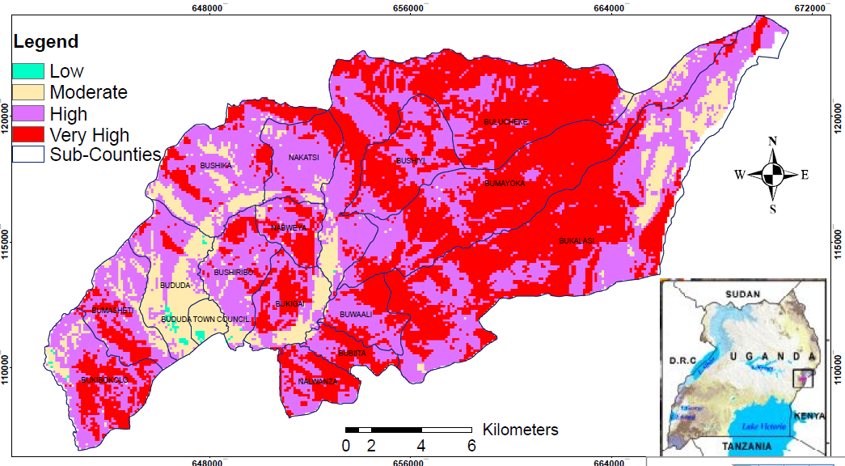
Output 2 :Landslide susceptibility map of Bududa district

Slide 54
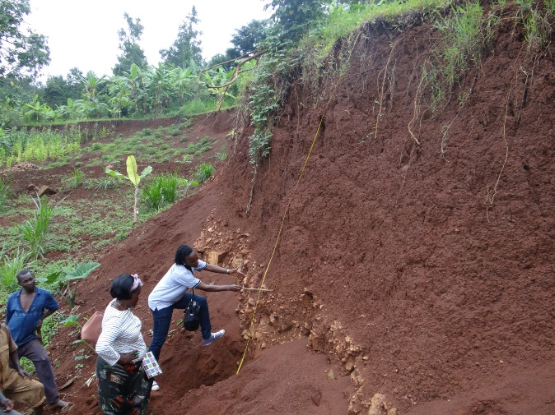
Challenges
Challenges encountered
  Inadequate technical capacity
  Cost of High resolution satellite images
  Difficult terrain
How were these overcome?
  Collaboration with academic institutions
  UNDP financial support
What challenges remain?
  Inadequate technical capacity
  Difficult terrain

Slide 55
Benefits
What benefits have come / are expected from the assessment?
  Community vulnerability brought to policy makers attention
  Guided the development of district annual work plan and budget
  Contributed to the development of the National El Nino Preparedness and Contingency Plan
  Facilitates resettlement planning
  Supports development of resilience projects for the community

Slide 56
www.understandrisk.org/URfinance
#URfAfrica

Slide 57
DISASTER RISK ASSESSMENT IN MALAWI:
An Overview
Samuel Gama
DEPARTMENT OF DISASTER MANAGEMENT AFFAIRS,
MALAWI

Slide 58
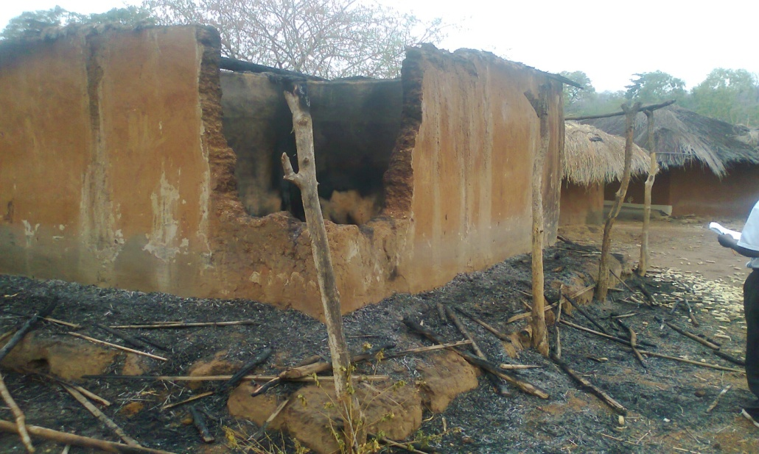
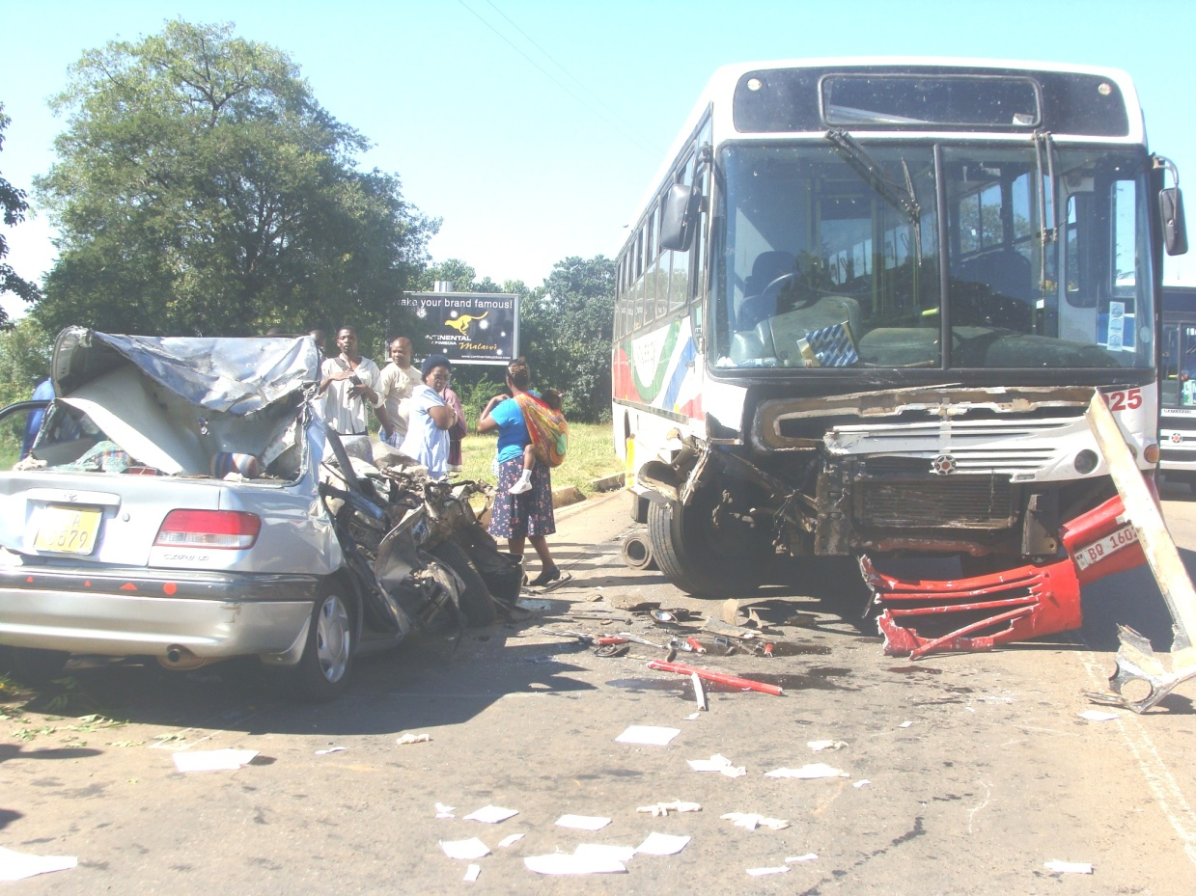
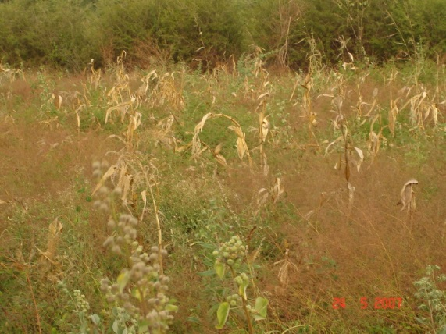
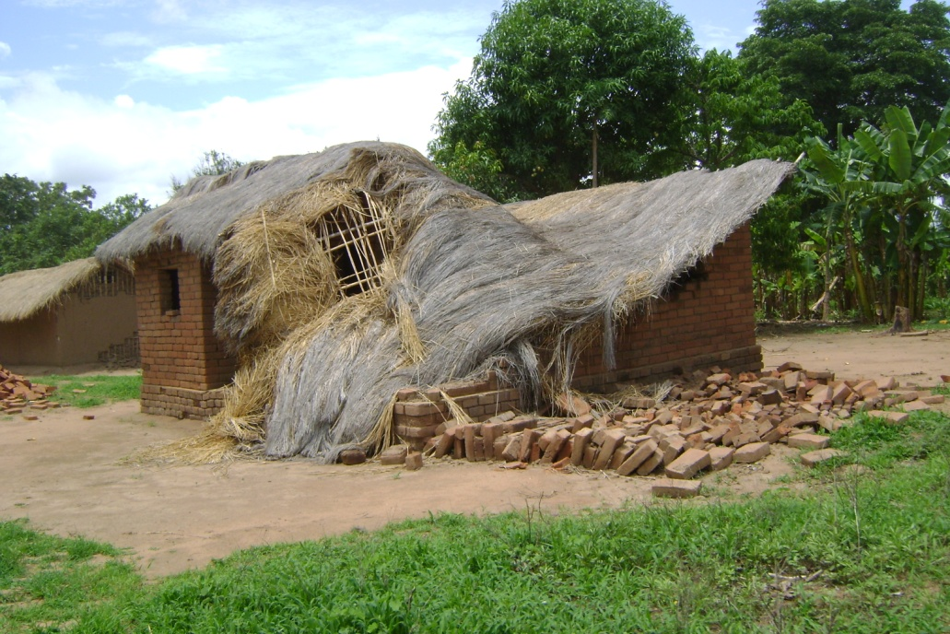
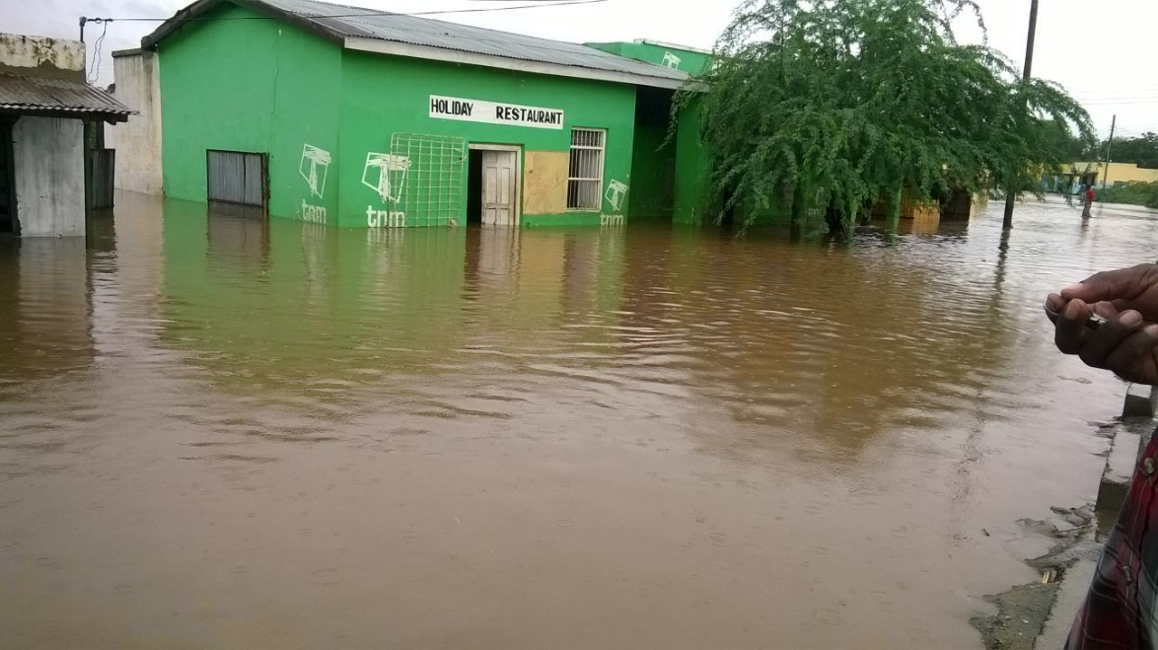
Disasters in Malawi
Malawi is prone to different types of hazards

Slide 59
Risk assessment
Understanding risk is one of the policy priority areas in the National Disaster Risk Management Policy:
  Policy Priority Area 2: Establishment of a comprehensive system for disaster risk identification, assessment and monitoring
The focus is on:
  Tracking hazards
  Monitoring hazards
  Regularly updating hazard maps
  Documenting and disseminating risk assessment information
  Developing integrated risk maps to identify areas and communities at risk

Slide 60
Risk assessments done in Malawi
Integrated flood risk Management Plan for the Shire Basin (IFRMP)
Hazard mapping and Community mapping

Slide 61
Integrated Flood Risk Analysis of Shire
Government of Malawi undertook an integrated analysis of the Shire River Basin with support from the World Bank, in 2013
Out put of the analysis:
  Construction and calibration of a hydrodynamic model for flood prediction;
  Simulation of floodplain inundation for floods of different return periods;
  Flood maps of the catchment;
  Framework for flood forecasting and an early warning system;
  Guidelines for flood mitigation measures.
Analysis led to
An integrated flood risk management plan for the Shire Basin an input to the Shire River Basin Management Programme.

Slide 62
Hazard and Community Mapping
Hazard & vulnerability mapping has been carried out in a number of districts by government and NGOs
While government’s approach has been to use consultants, internal government personnel and University students, NGOs have mostly used communities and local structures in the process.
TAs on Hazard & Community Mapping has been received from WB & RCMRD
The focus has been on exposure; sensitivity of physical environments to the hazards and adaptive capacity.
The hazard atlas can be accessed online on: 52.3.210.28/vulnerabilitytool/ and community mapping on open platform MASDAP

Slide 63
Importance of risk assessment to Malawi
Understanding risk, community and infrastructure at risk;
Lead into disaster prepared of the governments;
Determining risks to be integrated in development planning processes at different levels;
Strengthening the capacity of district and local planners to be aware of hazards that pose risks in their areas;
Planning for emergency response;
Empowering community members by having a better understanding of their areas in terms of risks and this informs preparedness;
Inform investment projects like the Shire River Basin Management project funded by World Bank, UNDP Recovery Support programme and the Malawi Floods Emergency Recovery Project

Slide 64
Challenges
Limited human, equipment and technology capacity;
The risk assessments are done by different stakeholders using different approaches without coordination;
Under-utilised of the Products of risk assessment by all stakeholders in Disaster Risk Management;
Due to climate change, population growth, urbanization and environmental degradation implies compounded risks which require new knowledge and approaches of conducting multi-risk assessments;
Lack of actionable programme/ project after assessment;
Inadequate funding of future risk assessments.

Slide 65
www.understandrisk.org/URfinance
#URfAfrica

Slide 66
WHAT RISKS?
A sample set of risk assessments from across the region and how to use them
Wednesday, November 18, 2015
African Union – Addis Ababa, Ethiopia

Slide 67
ADDRESSING CHALLENGES - Appendix
Better understanding of disaster risk and enhancing risk awareness for improved DRM
Involvement of public sector, private sector and civil society
Regional collaboration to share experience to promote better preparedness and disaster risk management
Strengthening governance and institutions to better manage disaster risk.
Demarcate who is responsible for and does what for DRM
Technical capacity building to operate and interpret risk modeling tools
Investing in economic and fiscal resilience
Adopt a ‘risk layer based’ approach with resources allocated based on the varying levels of risk facing the country
Consider combination of different financing mechanisms (a priori and ex ante)
Encourage private households to insure their houses and assets to reduce their vulnerability to disasters

Slide 68
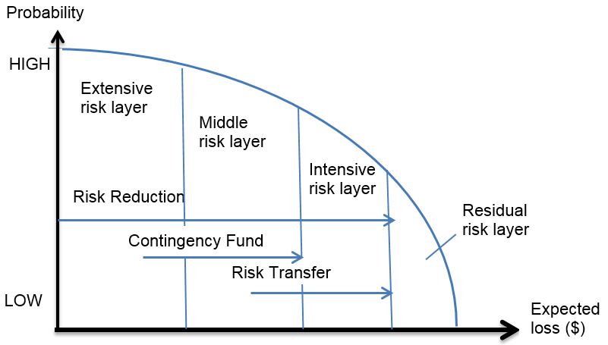
OUTPUT - Appendix
RISK LAYERED APPROACH

