Slide 1
Fire and other Learning Networks: Institutions For transformative resilience
Bruce Goldstein
Associate Professor
Environmental Studies and Environment Design
University of Colorado Boulder
Understanding Risk
October 24 2015

Slide 2
Thresholds and Transformations (Chaffin and Gunderson 2015)

Slide 3
What are Learning Networks?
Designed and facilitated
Multi-scalar, bridging organizations
Catalytic, not permanent
Multi-jurisdictional/organizational, supports a community of practice
Focused on social learning
Engaged in visioning as well as place-based experimentation
Disruptive but not contentious

Slide 4
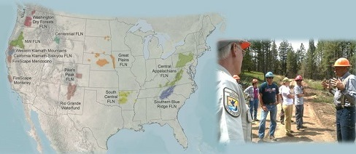
Fire Learning Network (FLN)
Notes:
Not bottom-up or top-down
Cross-jurisdicational and organizational
Focus on learning and experimentation: skunkworks

Slide 5
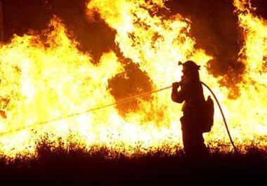
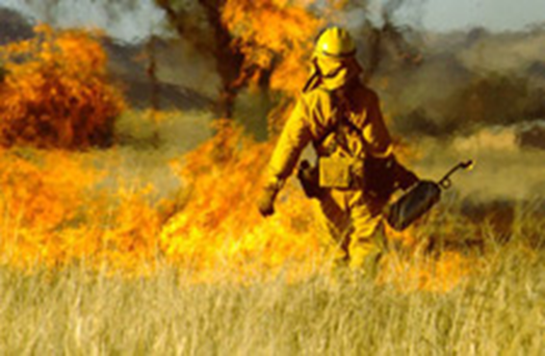
Fire Management’s Trap
Frustrated Transition
Crisis and Opportunity
Notes:
A war on fire was waged for more than 70 years among public land management agencies, worldwide.
Frustrated transition from the 1970’s
Disturbance ecology, Let-burn policies and prescribed fire
But, steps toward change were tentative, sporadic, and have not taken hold.
More than 98% of fires, regardless of ignition, were suppressed through 2005.
Crisis of late 1990s: WUI, Increasing incidence and magnitude of fire, Increasing costs of containment
Opportunity: Policy Responses: U.S. Healthy Forests Restoration Act and National Fire Plan: recognize the importance of restoring fire adapted ecosystems
Enduring Obstacles
Agency firefighting culture
Jurisdictions, budgets and incentives
Practice on the ground is slow to change, tied to professional identity, alternative tools and training, etc.

Slide 6
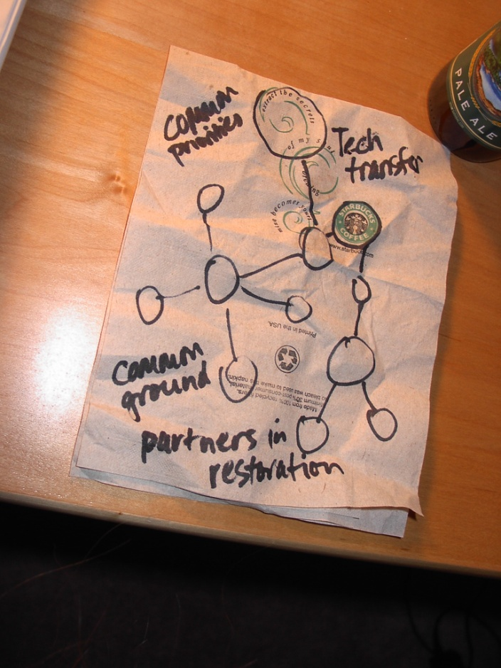

U.S. Fire Learning Network
National Fire Roundtable
Network approach
Notes:
The US FLN was created in response to the fire crisis and the window of opportunity created by the unveiling of the National Fire Plan in 2001.
TNC, land mgmt agencies, scientists hosted a National Fire Roundtable to figure out what to do to accelerate the transition to ecological restoration.
Established the US Fire Learning Network the following year to engage in a two year experiment.

Slide 7
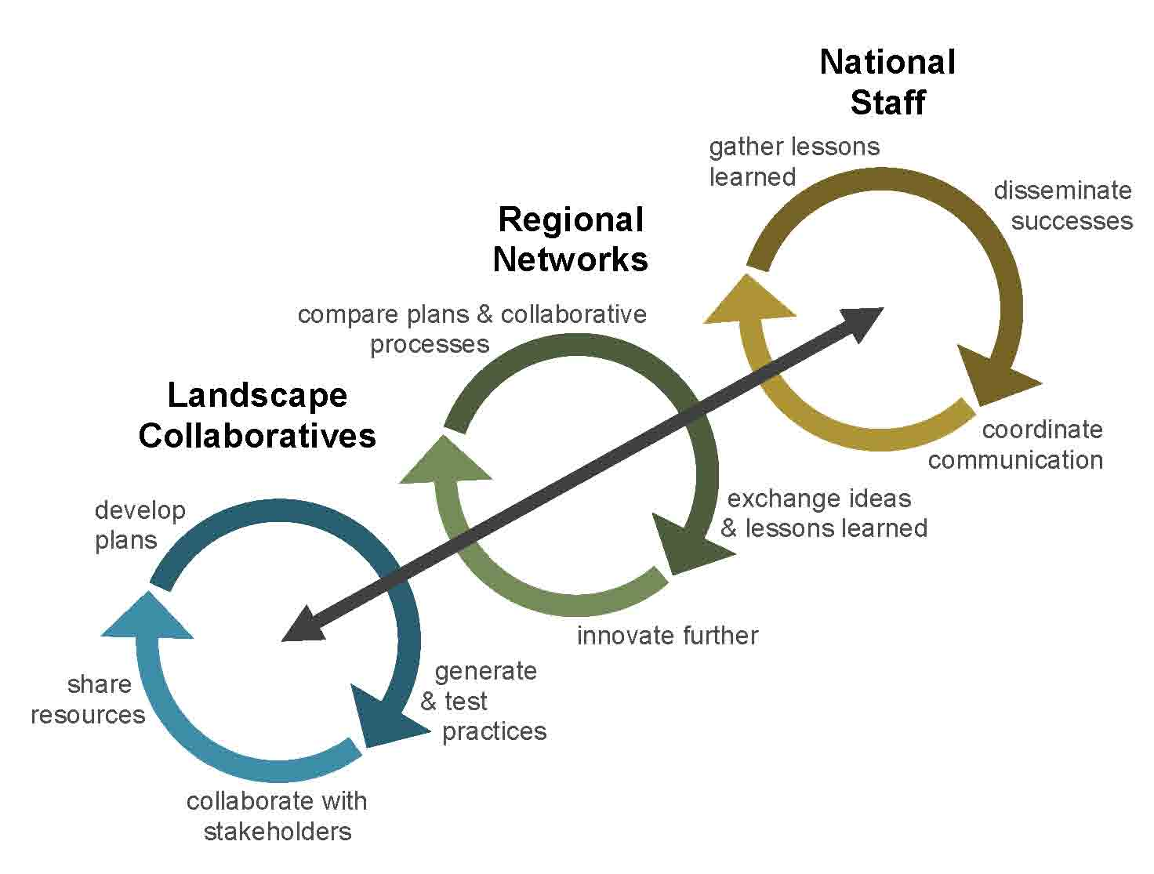
Within, across, between…

Slide 8
Stories Within Communities
Homework 1
Past
Homework 2
Present
Homework 4 Implementation and monitoring
Homework 3 Future Alternatives
Notes:
4 step planning process applied through 4 homework exercises.
This series of exercises outlines a framework for planning that facilitates the construction of a fire restoration narrative.

Slide 9

Across Communities
Polyvocal storytelling
  Common narrative arc
    “Golden Age”
  Villain and redeemer
Shared social imaginaries
  What is the social-ecological system, and what knowledge is credible to identify it?
  What is our role, what are our shared values?
  What are desired outcomes and constraints, and how can we prevail?

Slide 10
Productive Network Tension
Autonomy vs.
Coherence
Informality
Openness
Learning
Innovation
Consistency
Mutual comprehension
Support
Emergence
Notes:
Collaborative Network's Tension
Autonomy
…informal and open to local conditions
…learning and innovation
... generate own problem definitions and solutions
Vs.
Coherence
… across and between scales
… mutually comprehensible and supportive
… emergent properties

Slide 11
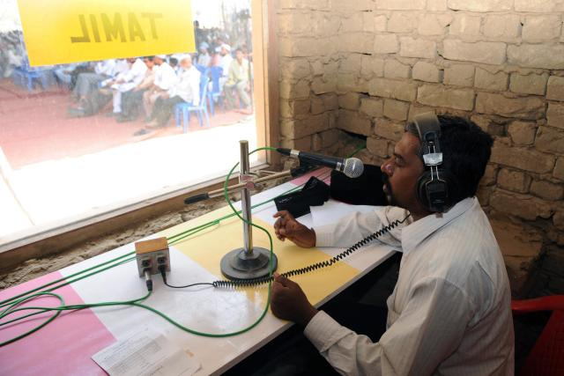
Between Communities and Sponsors
Top-down support for bottom-up experiments
Netweavers as translators or boundary workers
Interactional expertise
Coordination without alignment or loss of difference

Slide 12

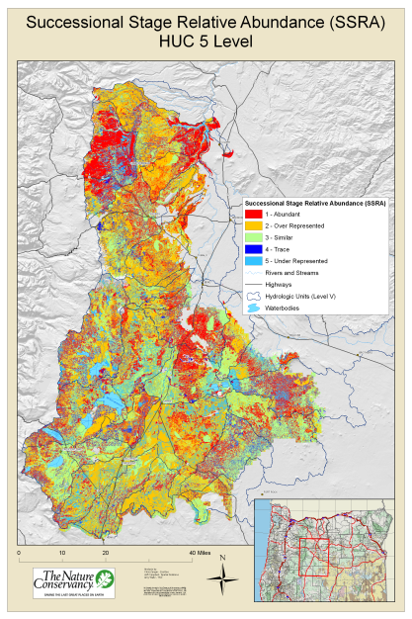
What Kind of Transformation?
Transforms knowledge and practice
Transforms relationships
  Reconstructs identity
  Builds solidarity
Transforms institutions
  Introduces new practices
    Collaboration
    Fire restoration
  Influences forest plans and national policies

Slide 13
Next Questions About Networks and Transformation
How does collaborative learning increase transformative capacity?
How can networks support critical and reflective learning rather than just “innovation?
  Resilience of what, for whom?
Netweaving as interactional expertise or choreography
  How do netweavers align communities while preserving essential differences?
Questions about collaborative resilience
  Are resilient systems co-constructed?
  Is a resilient systems a boundary object?

Slide 14
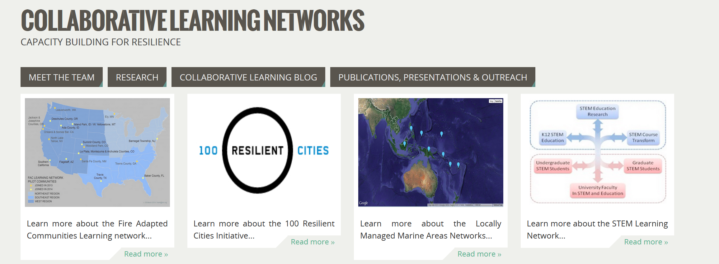
Network Comparisons Underway
Website: www.brugo.org

