Slide 1
Hazard and Risk Mapping Session –
Saturday 1.30pm – 3pm

Slide 2
Regulatory Hazard and Risk Mapping - FEMA
Notes:
In the US we are somewhat spoilt. Recognizing the unacceptable losses the US was suffering annually, the federal government implemented the NFIP, and the FIRM mapping process to support that program.
Our session tomorrow will highlight the regulatory flood mapping process, how it is implemented and the tools that are behind it, and how it has evolved and been enhanced over many years, especially since the advent of computer modeling and mapping technologies.

Slide 3
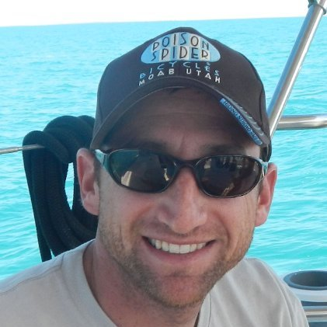
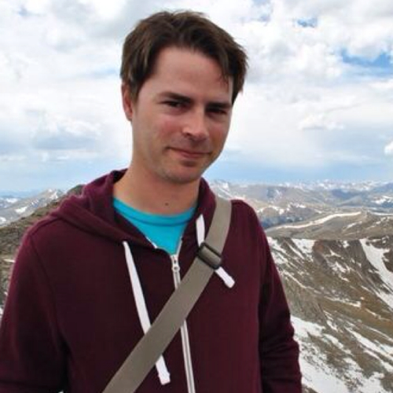
Speakers – Hazard and Risk Mapping Session
Craig Jacobson (Icon Engineering) - Regulatory Mapping of Risk
Craig is a professional engineer and principal with ICON Engineering. In Boulder, Craig has managed several flood hazard mapping studies and mitigation planning efforts both prior to, and following the 2013 floods. ICON’s current study along Skunk Creek actually reviews flooding surrounding CU’s Kittredge Campus, where we are at today.
Eben Dennis graduated in 2012 from the University of Colorado Denver in the Geography and Environmental Studies program. Eben is ICON’s GIS Coordinator and specializes in Open Source and Web Mapping applications.

Slide 4
Sharing Hazard Information with the Public
Helping the Public Understand their Risk
Notes:
……tools that can identify your level of risk to hazards, in this case wildfire, identify optimal safe evacuation routes, routes to locations that might be safer or even specifically designed to save you, and then ….if you’re just a worrier….your exposure to just about anything that might whack you (the multi.-hazard approach)

Slide 5
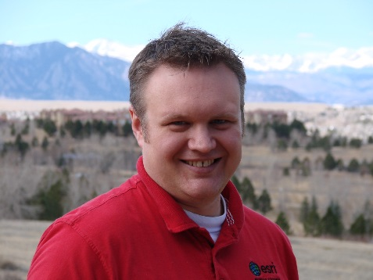
Speakers – Hazard and Risk Mapping Session
A GIS Perspective on Trends in Mapping Hazard and Risk
Jeff Baranyi, Emergency Management Technical Lead, Esri
Mr. Baranyi is the Emergency Management Technical Lead on the Patterns & Practices Industry Framework and Standards team at Esri. He is responsible for working closely with Esri’s Public Safety team to define and advocate a set of industry focused solution patterns that promote the vision and value of the ArcGIS platform.
Jeff is also a member of Esri’s Disaster Response Team where he advises on best practices and data as well as support users in times of need. He has been with Esri since 2000 and started as a consultant in the Professional Services Group. Mr. Baranyi holds a Masters of Engineering in Applied Remote Sensing and Geographic Information Systems and a B.S. in Biology from the University of Michigan.

Slide 6
STEEP, CONFINED
TO SEMI-CONFINED VALLEYS
Transport Capacity < Supply
Transport Capacity > Supply
Vertical Erosion
Vertical Deposition
Lateral Erosion

Slide 7
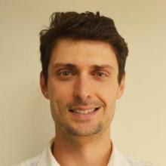
Speakers – Hazard and Risk Mapping Session
Joel Sholtes - Mapping Geomorphic Risk
Joel is a river researcher and consultant based out of Fort Collins, CO. His background is in physical river processes including hydrology, fluvial geomorphology, and sediment transport. He is part of a team developing a protocol for mapping fluvial hazards within river corridors for the State of Colorado. His current research involves linking geomorphic and hydraulic variables with severity of river change during a flood to predict where fluvial hazards may be most severe at a watershed scale. Joel recently obtained his PhD from Colorado State University, Dept. of Civil and Environmental Engineering, and has a Master's in physical geography from the University of North Carolina at Chapel Hill.

Slide 8
Remote Sensing of Hazard and Risk

Slide 9
Speakers – Hazard and Risk Mapping Session
Vicki Bassett - Mapping Hazards & Risk Mitigation with Satellite Imagery - DigitalGlobe FirstLook Coverage of the September 2013 flooding
Vicki has been with DG for 4.5 years and brings her experience in collection strategy and revenue optimization to her current role in Product Management supporting FirstLook, DigitalGlobe’s global event coverage product.

