Slide 1
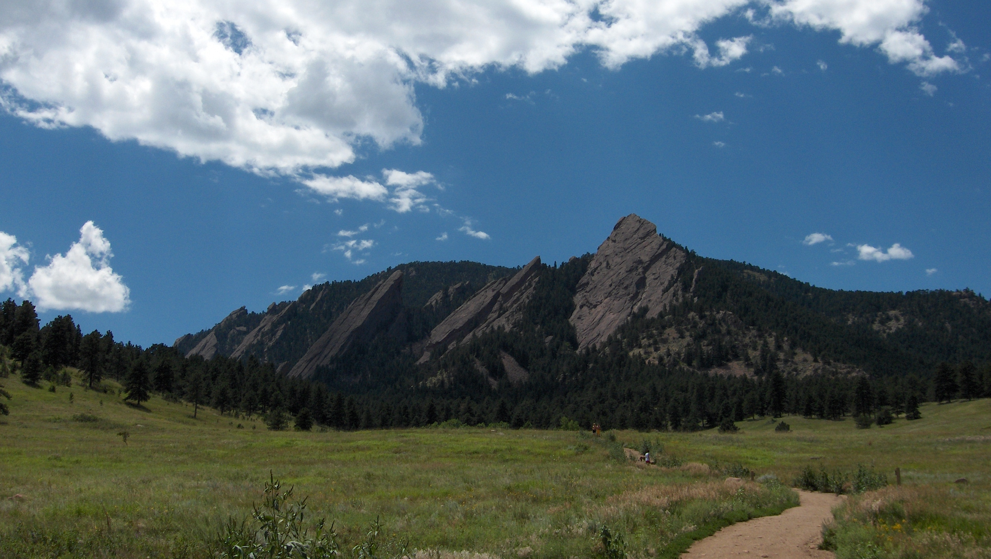

Simone Balog –
Understanding Risk:
A Community
October 25, 2015

Slide 2




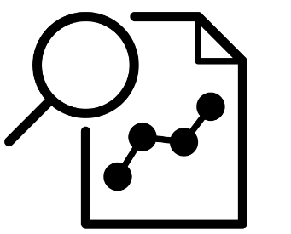

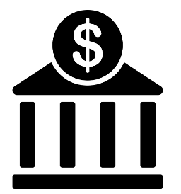

What is the Understanding Risk (UR) Community
  Disaster risk identification (risk assessment and risk communication) experts and practitioners
  3,300+ members
  From 125+ countries
  Range of sectors
  Managed by the Global Facility for Disaster Reduction and Recovery (GFDRR), part of the World Bank
Government
NGOs
Academia
Research
Multilaterals
Private

Slide 3
Origins of UR
  ~10 years ago, disaster risk assessment field emerged for non-insurance purposes
  GFDRR recognized need for a community in the field
  UR Community was born in 2010 to:
    Facilitate nontraditional partnership and collaboration
    Share knowledge
    Discuss innovation and best practices
    Create a space for learning
    …all in the field of disaster risk identification
  Actively promote diversity of stakeholders
  Global representation
  Attendance is free and forum is open

Slide 4
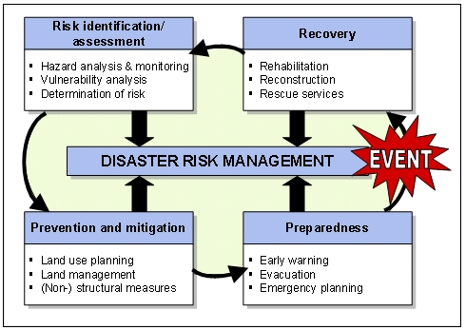
What is this field?
  Risk assessment
    Hazard
    Exposure
    Vulnerability
  Risk communication
    Psychology of risk
    Behavior change
  Understandable
  Actionable
Source: International Federation of Surveyors, 2006

Slide 5
UR Forums – The History
Global Forums
Year | Location | Attendance | Theme
2016 | Istanbul | 800 – 1000 | TBD
2014 | London | 840 | Producing Actionable Information
2012 | Cape Town | 500 | Best Practices in Disaster Risk Assessment
2010 | Washington, DC | 450 | Innovation in Disaster Risk Assessment
Year | Location | Attendance | Theme
2015 (Nov) | Addis Ababa, Ethiopia | 300 - 500 | Building Financial Resilience of African Nations and Communities to Climate and Disaster Risks
2015 (Oct) | Boulder, Colorado, USA | 100 - 150 | Collaboration and Communication to Strengthen Our Community
2014 | Port-au-Prince, Haiti | 500 | Innovate to Prevent (Innover pour prévenir)
2012 | Belo Horizonte, Brazil | 500 | Understanding Nature and Reducing its Impacts (Entendendo a Natureza e Reduzindo os Impactos)
UR+ Events

Slide 6
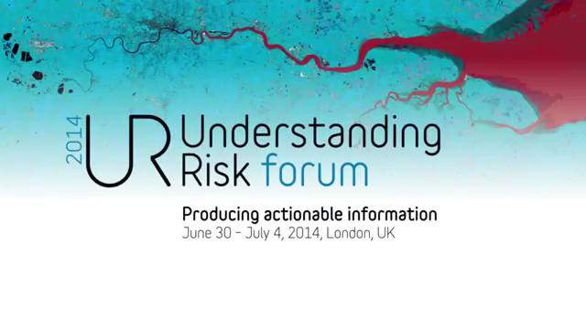
UR2014 – London

Slide 7
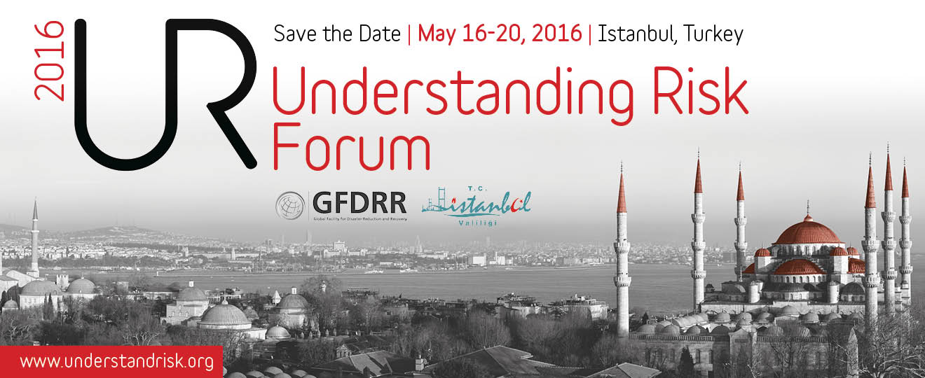
Next up…
  Fourth UR Global Forum
    Istanbul, May 16 – 20, 2016
  Become a member at www.understandrisk.org
    LinkedIn group: Understanding Risk Community
    Twitter: @UnderstandRisk

