Slide 1



air • planet • people
Learning to Love Volatility
Mari Tye
Understanding Risk Boulder
25 October 2015

Slide 2
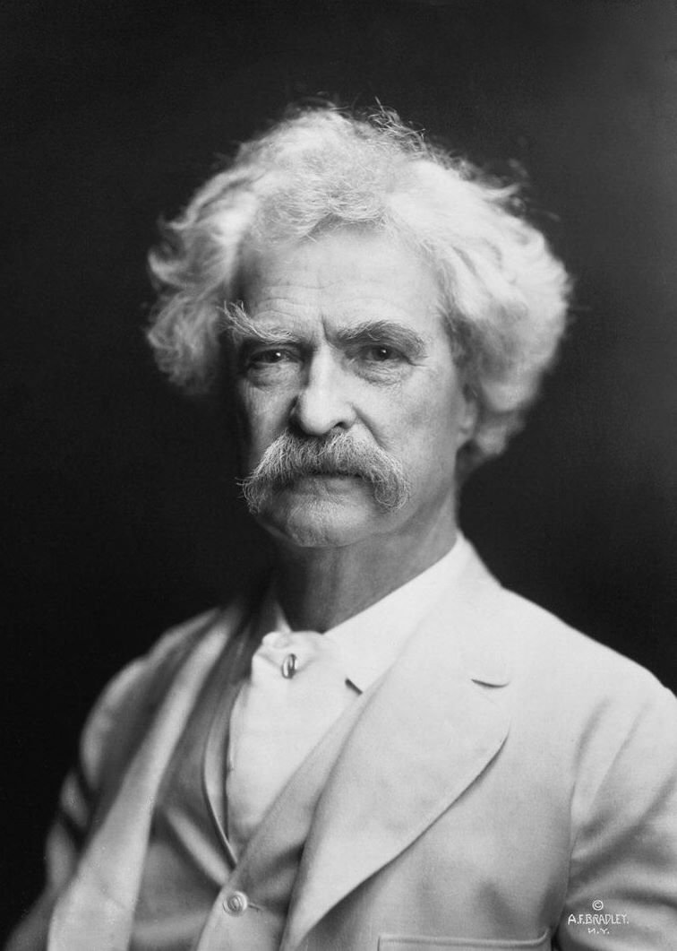
“Climate is what we expect, weather is what we get”
Mark Twain
Notes:
weather individual events local, short
climate averages over long period

Slide 3
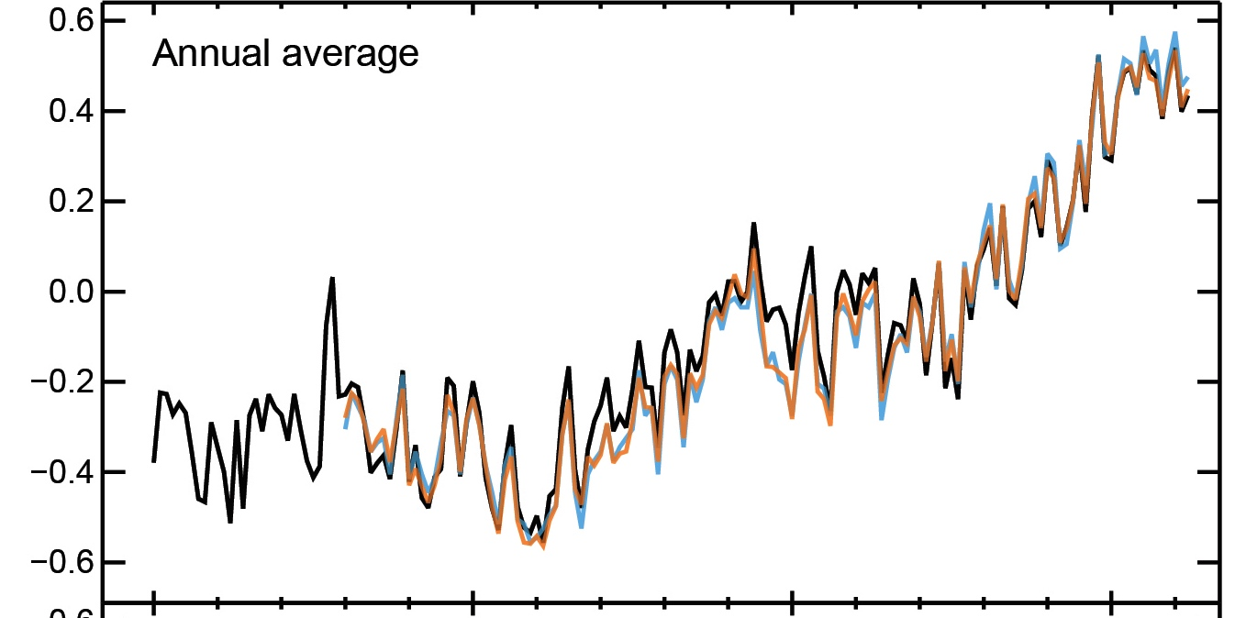
Volatile and Changing
Temperature Anomaly (1961-1990) (ºC)
1860
1900
1950
2000
IPCC AR5 (2014)
Notes:
climate inherently volatile:
seasons, trends, shifts, decadal

Slide 4
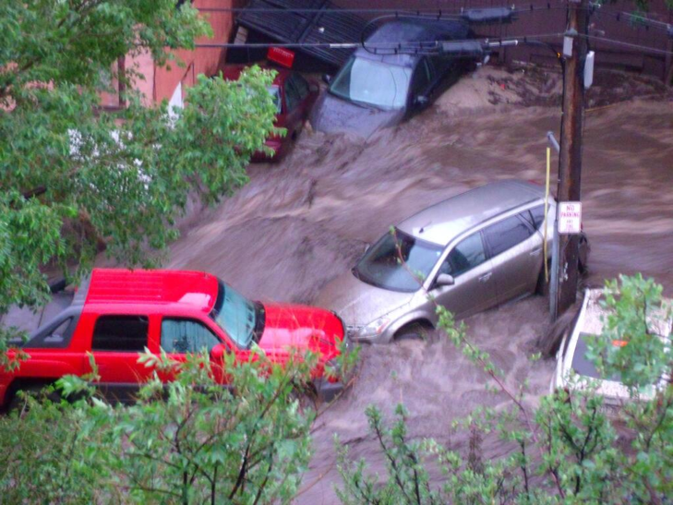
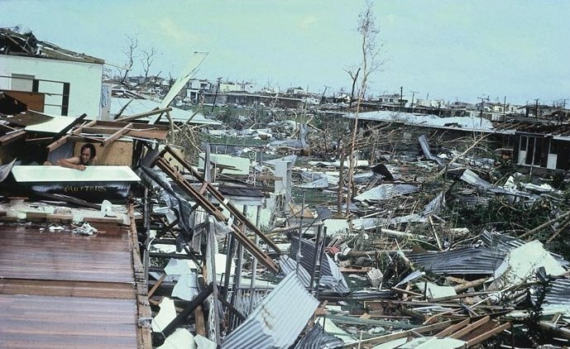
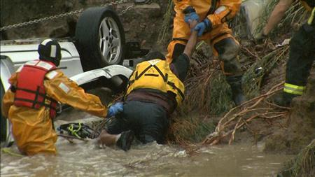
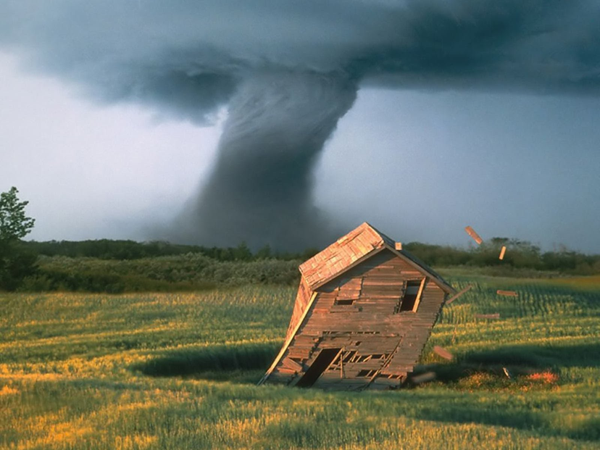
Notes:
Most interested in high impact weather
floods, hurricanes, tornadoes
ice storms,
100 year events…

Slide 5
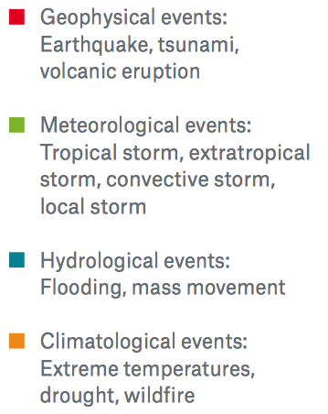
Increasing Frequency of Natural Hazards
1000
Geophysical
Weather
Flood
Climate
800
600
400
200
0
1980
2010
1990
2000
2014
Munich Re
Notes:
Global freq compile by Munich Re
Broken down by phenomenon
Doubled since 1980s most recent decade.

Slide 6


Understanding Risk
1 in 100 return period = 1% per year
ALSO = 27% chance in 30 years!
OR 13% of twice in 100 years
What is your realistic risk tolerance?
Notes:
30% chance of rain would you carry an umbrella?
and let’s not forget uncertainty from poor and scarce data.
plus cascading uncertainty from climate scenarios and models through to decisions

Slide 7
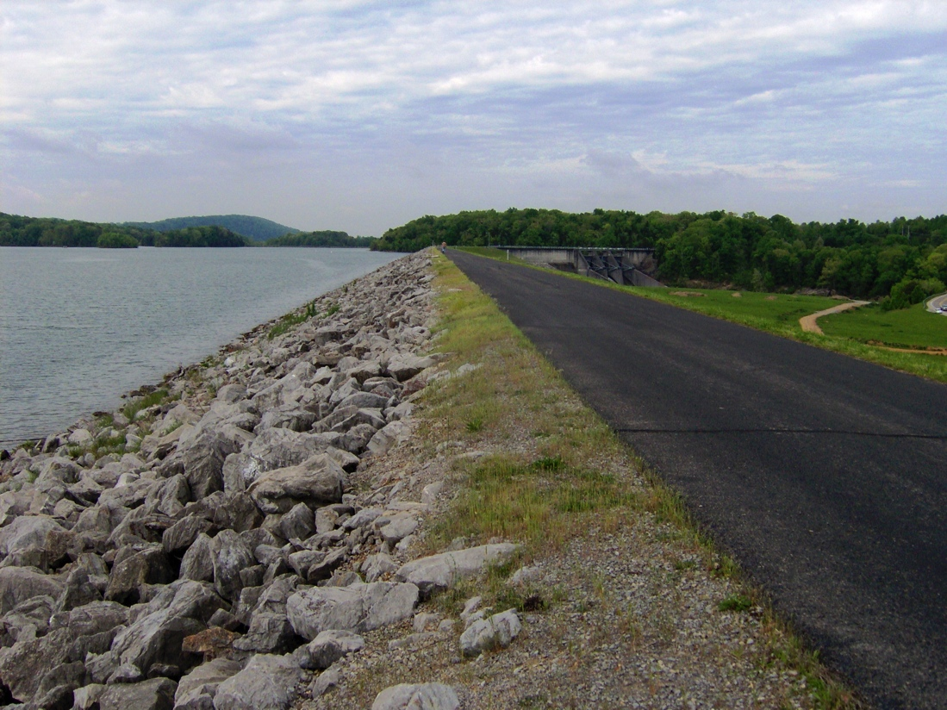
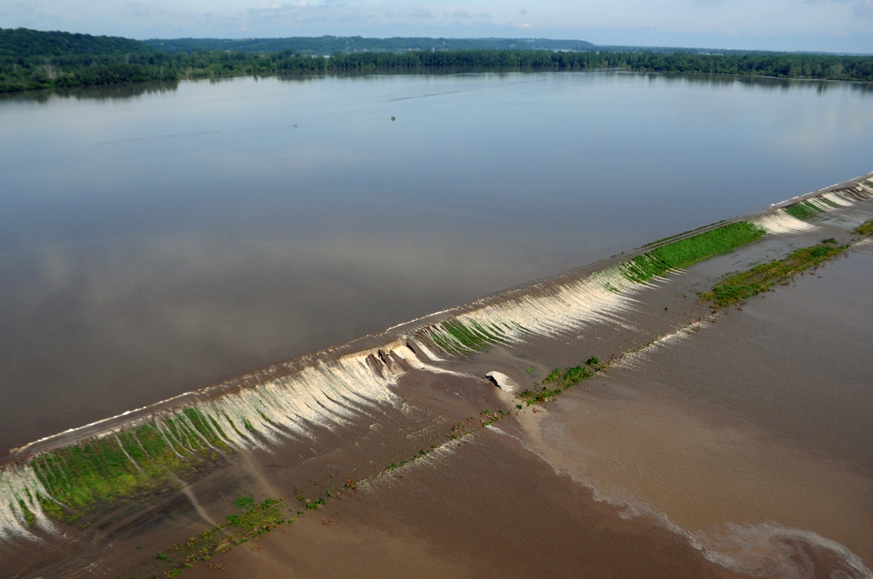
Resistance ≠ Resilience
Notes:
how we deal with risk is to try to keep the hazard out
but what happens when you underestimated the worst-cast scenario?
"Tellico-dam-dike-tn1" by Brian Stansberry - Own work. Licensed under CC BY 3.0 via Commons - https://commons.wikimedia.org/wiki/File:Tellico-dam-dike-tn1.jpg#/media/File:Tellico-dam-dike-tn1.jpg
Water flows from the Missouri River over levee L-550, located north of Highway 136 in Atchison County, Mo., June 19, 2011. The local sponsor reported overtopping of the levee to the U.S. Army Corps of Engineers the morning of June 19. The levee is in the Federal Program (PL 84-99) and is operated and maintained by a non-federal sponsor. It was constructed by the Corps in the late 1940s. (U.S. Army Corps of Engineers photo by Carlos J. Lazo)

Slide 8
Conservation
Reorganization
Potential
Growth
Resilience
Connectedness
Release
Gunderson & Holling (2002)
Notes:
potential could be money, room to grow etc. from active to passive
connected from weak to strong
ecological resilience – a cyclic approach. resilient when don’t cross a threshold out of that cycle
engineering resilience speed of recovery.
focussing on staying in conservation phase
best resilience combines both, has lots of little active cycles or redundancy so don’t cross the threshold.
when we don’t allow for failure we keep crossing the transition to another phase.

Slide 9
What is Graceful Failure?
Failure isn’t IF but WHEN and HOW BADLY
Basis of earthquake building design
Incorporates redundancy
Continue operations at reduced level
Quicker recovery
Allowance for uncertainty
Failure at ACCEPTABLE risk levels
Notes:
brick houses fail catastrophically, wooden frame don’t.
not unusual in any civil engineering design.
just not as well incorporated.

Slide 10
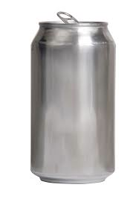


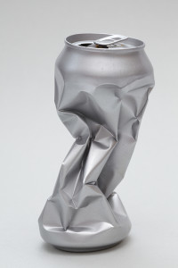
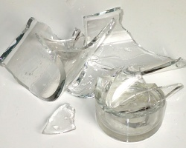
What is Graceful Failure?
Notes:
aluminium is example of a soft failure allowing operation at a reduced level
buildings operate lights at lower levels and lifts lower speed in power failure
low bandwidth online videos shown at lower resolution
highway capacity always ungraceful failure once capacity filled.

Slide 11
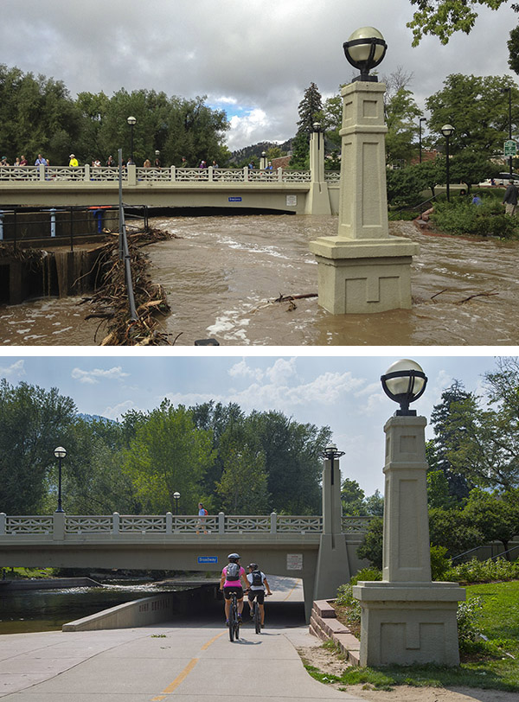
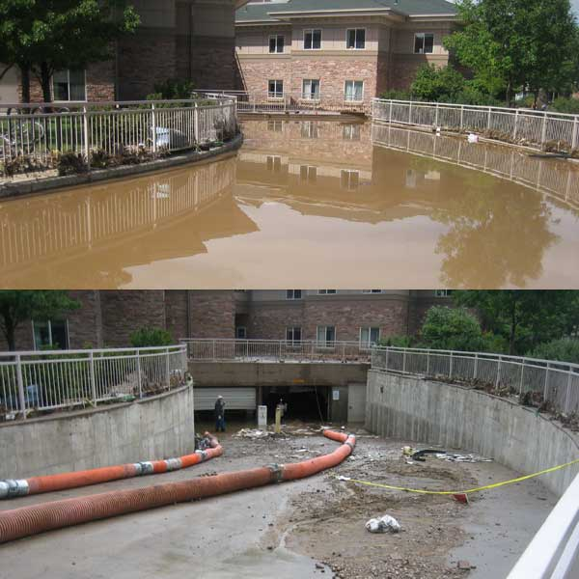
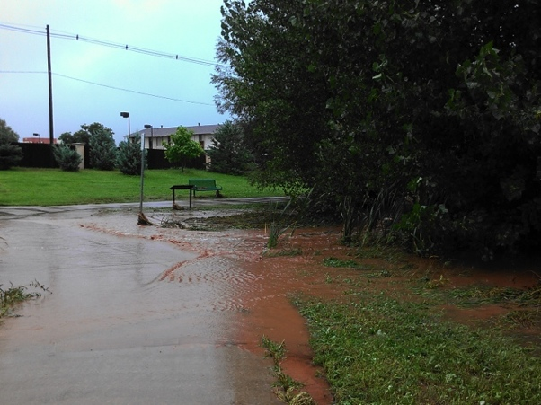
Resilience in Boulder

Slide 12
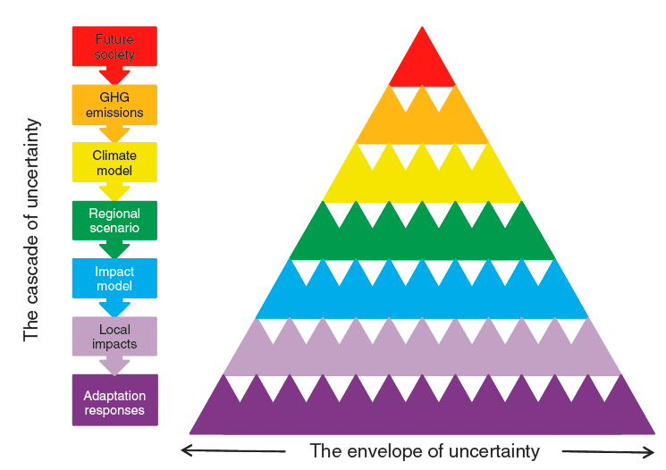
Cascading Uncertainty
Wilby and Dessai (2010)
Decision-Making
Notes:
(Assessment of needs,
decision entry points,
institutional constraints,
politics etc.)

Slide 13
Graceful Failure
Allows for volatility and uncertainty
Considers the whole system
Applies to many different decisions
Enhances resilience
Tye et al. (2015)
Proc. ICE Forensic Engineering
Notes:
Sometimes it requires identifying the less critical components that can be lost
and id’ing weak areas that need to be reinforced
Just need to get the stakeholders together
Needs strong collaboration ongoing

Slide 14

Mission: Enabling improved societal planning for weather and climate extremes through:
Partnering academia, governments, businesses & communities
Using cutting-edge engineering, science and technology
Developing tools in support of decision-making
Reducing catastrophic impacts through graceful failure.
Notes:
Strengthen society’s resilience to weather and climate extremes.

Slide 15

Societal Planning Tools
Global Risk, Resilience and Impacts Toolbox (GRRIT):
Open source
Developed by the community
Fully supported
Flexible to future technology and user demands.
Notes:
Quick:
Like WRF.

Slide 16




Framework
Database
Notes:
fully open source
community supported
community contributions
one of several apps
hosted and maintained at NCAR

Slide 17
www.ecep.ucar.edu
UCAR AtmosNews: Engineering for Disaster
ecep@ucar.edu
@ECEPNCAR
Notes:
Community portal: data and models available under resources
project descriptions
publications.
Blogs: Katrina and contributions sought!

