Slide 1
Karen MacClune
Senior Scientist, ISET
Thresholds and Transformation: Local Fires, Floods, and the Inter-Mountain Alliance

Slide 2
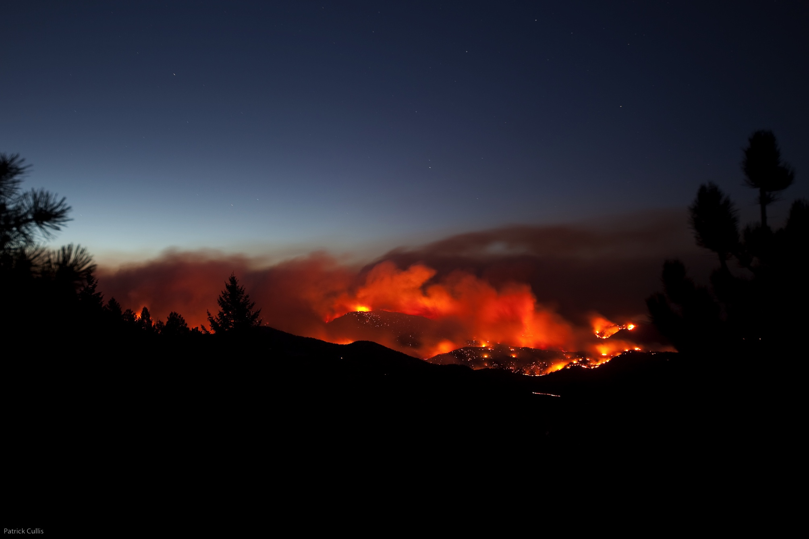
Photo credit: P. Cullis
Notes:
In 2010 mountains west of the City of Boulder experienced the 4-mile Fire.
At the time it was the most destructive fire in CO history.

Slide 3
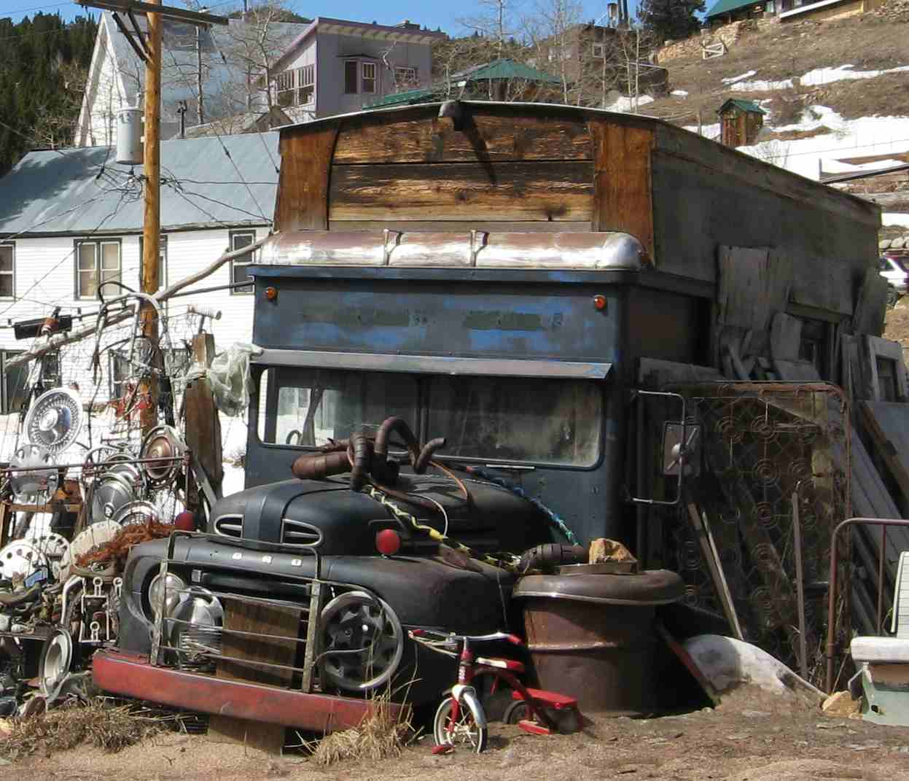
Birth of the InterMountain Alliance
The Fourmile Canyon Fire was a catalyst for change in the mountain communities west of Boulder.
Allenspark, Lyons, Nederland, Ward, Gold Hill, Jamestown, Bar-K, and Left Hand Canyon
A forum for communities to assist each other in preparing for disaster and in planning for the future

Slide 4
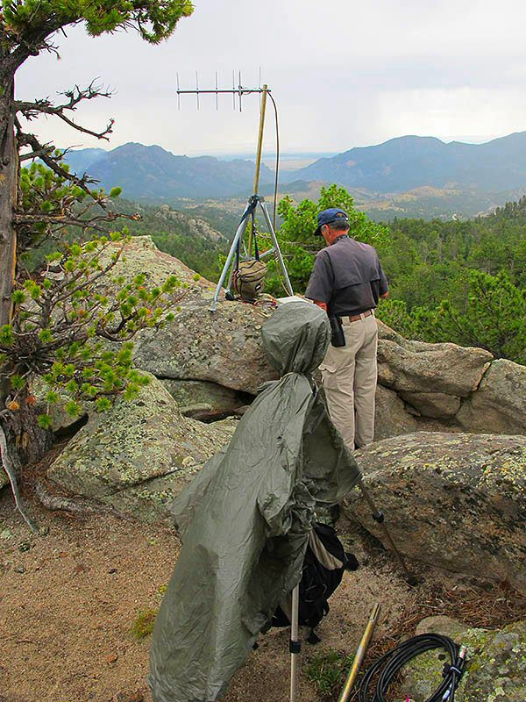
Support and growth
IMA was recognized and supported by the County Office of Emergency Management to:
document the resources present in each town
devise community specific plans to support local volunteer fire departments
create a partnership with Boulder County Amateur Radio Emergency Services to design a Mountain Emergency Radio Network

Slide 5
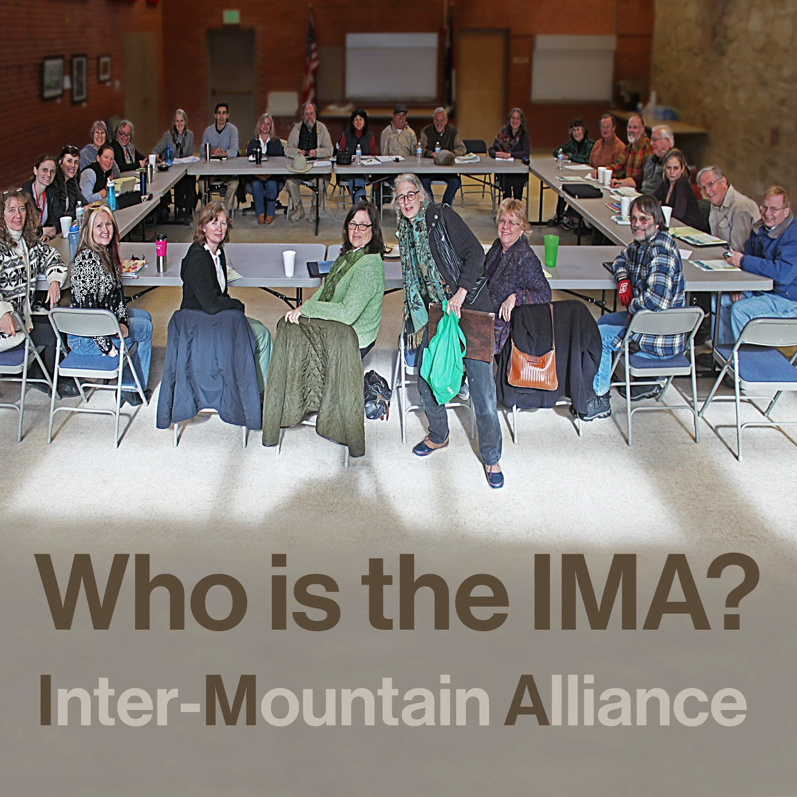
Co-Benefits
Specific actions were important, but so were the connections and networks built.
Notes:
Current reseach (e.g. Daniel Aldrich, Northeastern Univ.) – social capital serves as the critical engine for post-disaster recovery.
These ties are more important than factors such as damage from the event, wealth, or investment in physical infrastructure.

Slide 6
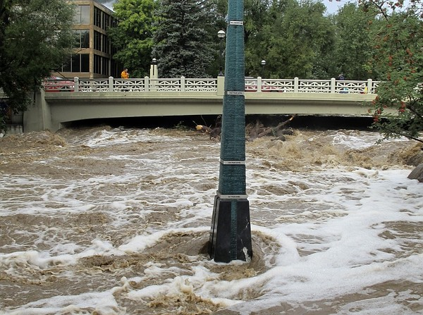
Photo credit: Associated Press
Notes:
Fast forward to the 2013 floods…. Did the IMA make a difference?

Slide 7
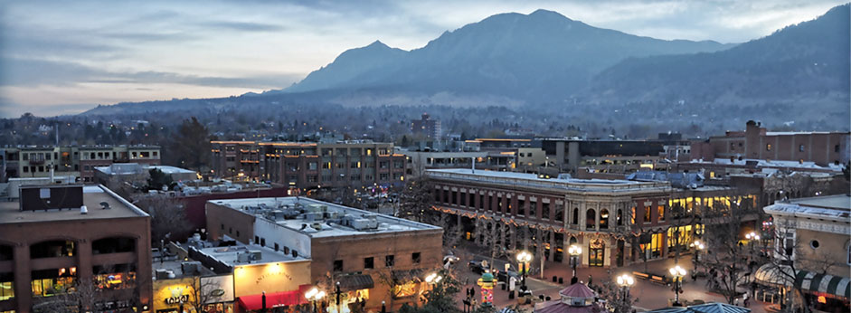
The Flood of 2013 and the IMA
Both the actions and social networks made a difference
Notes:
Radio network was instrumental in transmitting information to county emergency managers and between mountain communities
Communities organized to self-rescue
Loss of lives was minimal – which, given the conditions, was pretty phenomenal.
Virtually every mountain community has an amazing survival story, often because neighbors showed up at a critical juncture.

Slide 8
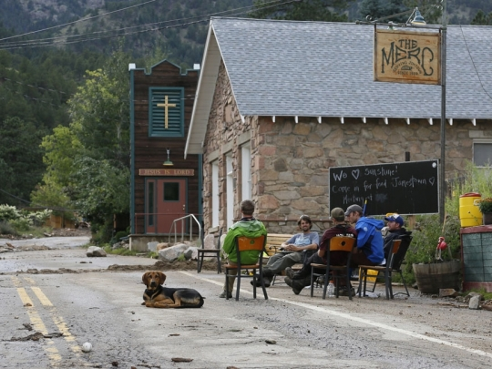
What have we learned…
Many citizens have a reliance on government response that is out of proportion to what is possible in a large disaster.
How people responded, both during and after the flood, is heavily constrained by the culture in which they function.
Boulder and Larimer Counties are now working on building a culture of connectedness and interdependence – using the IMA as a model
Notes:
Govt reliance – particularly true in urban areas
A change in behavior will require a culture change

Slide 9
…and what does it mean for transformation?
Disaster resilience is not only about resource and economic capacity.
Cultural blinders at all levels can limit our preparedness, leave us vulnerable, limit our response, and hobble our recovery
The flood and the fire were beyond anything planned for – and this is increasingly going to be our reality
Community is the fabric that enables us to respond. Strong networks can prevent events from escalating to disasters.

