Slide 2
I. Sustainability, Resilience & Lao Tsu

Slide 3
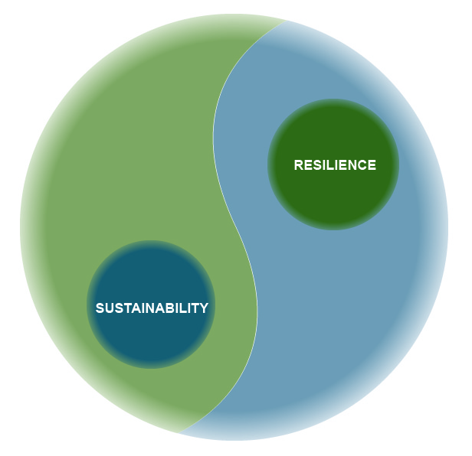

Slide 4
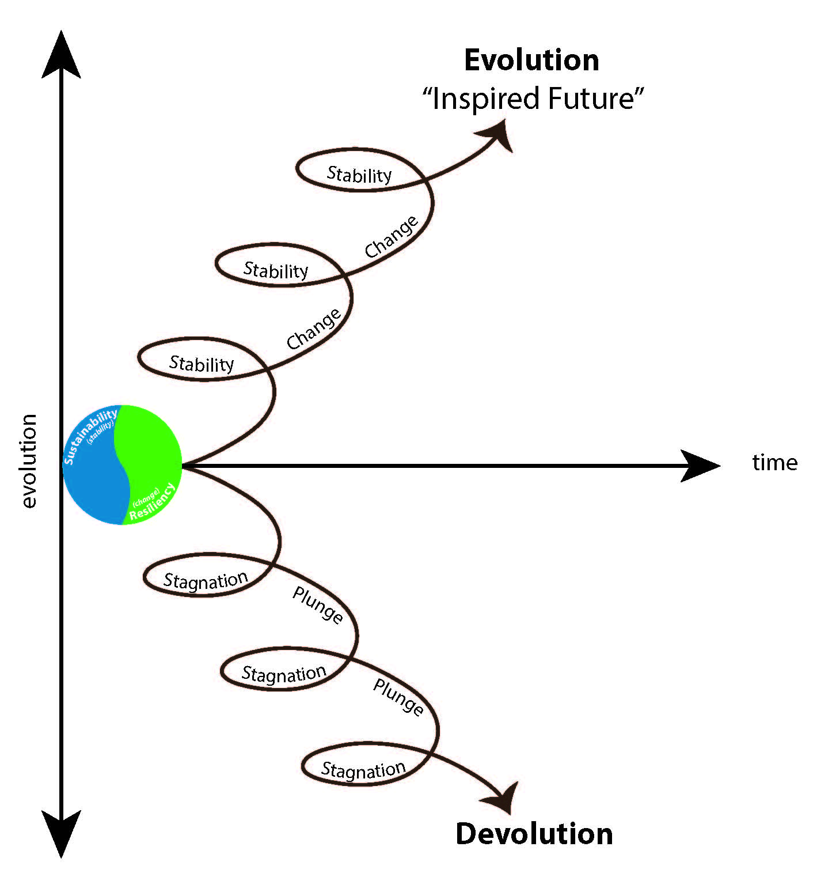

Slide 5
Resilience Priorities Pyramid
From: The Institute for Social and Economic Transitions (ISET)

Slide 6
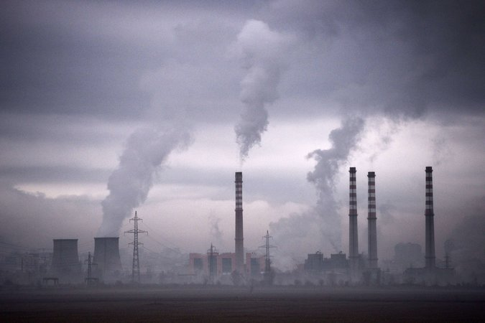
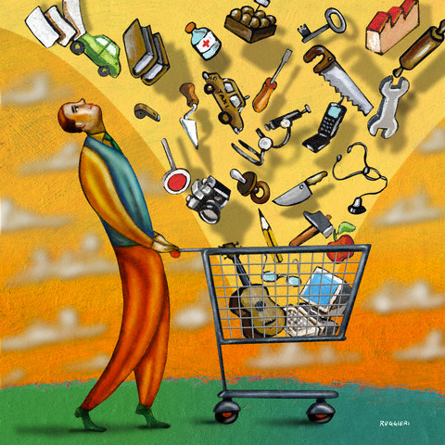
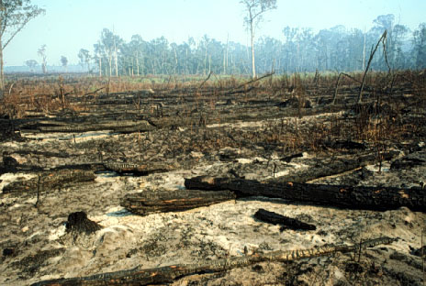
II. Getting the Problem Right:
Climate Change As Sustainability Indicator
Energy
Consumption
Ecosystems

Slide 7
A Plausible Path to an 80% Emissions Reduction
= 80% or More Clean Energy System

Slide 8
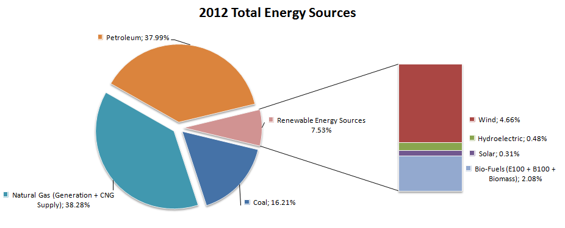
Boulder’s Energy Picture
2012 Energy Sources
Petrol 38%
Renewables
7.5%
Wind ~ 4.6%
Hydro ~0.5%
Solar ~0.3%
Other ~2.1%
Nat Gas 38%
Coal 16%
From: 2012 Boulder GHG Inventory—www.boulderclimate.com

Slide 9
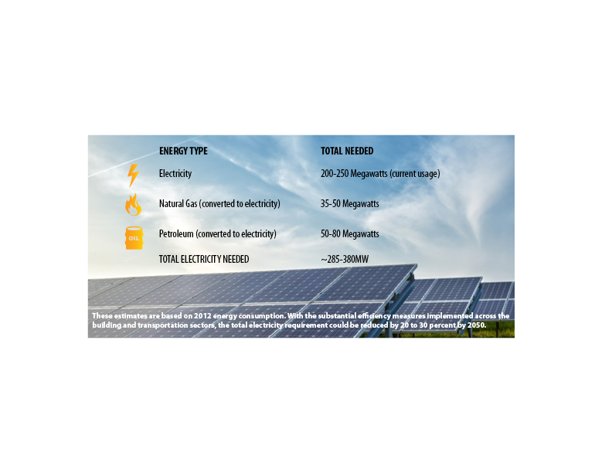
How much clean energy do we need?
How much clean energy do we need?
285-380MW

Slide 10
How much clean energy is available?
How much clean energy is available?
~ 600MW of solar rooftop capacity for Boulder and surrounding area (NREL & Mapdwell Analysis)
Currently Colorado generation ~2,332 MW
DOE projects capacity at 387,220MW
15X more latent energy below and around the average house than is needed to heat and cool!

Slide 11
III. Managing Climate Change Risk By Transforming the Problem
3 Stories from the Frontier of Change of Energy System Change
Household Level Whole Systems Change
Institutional/Commercial Level Change
Regional Systems Change

Slide 12
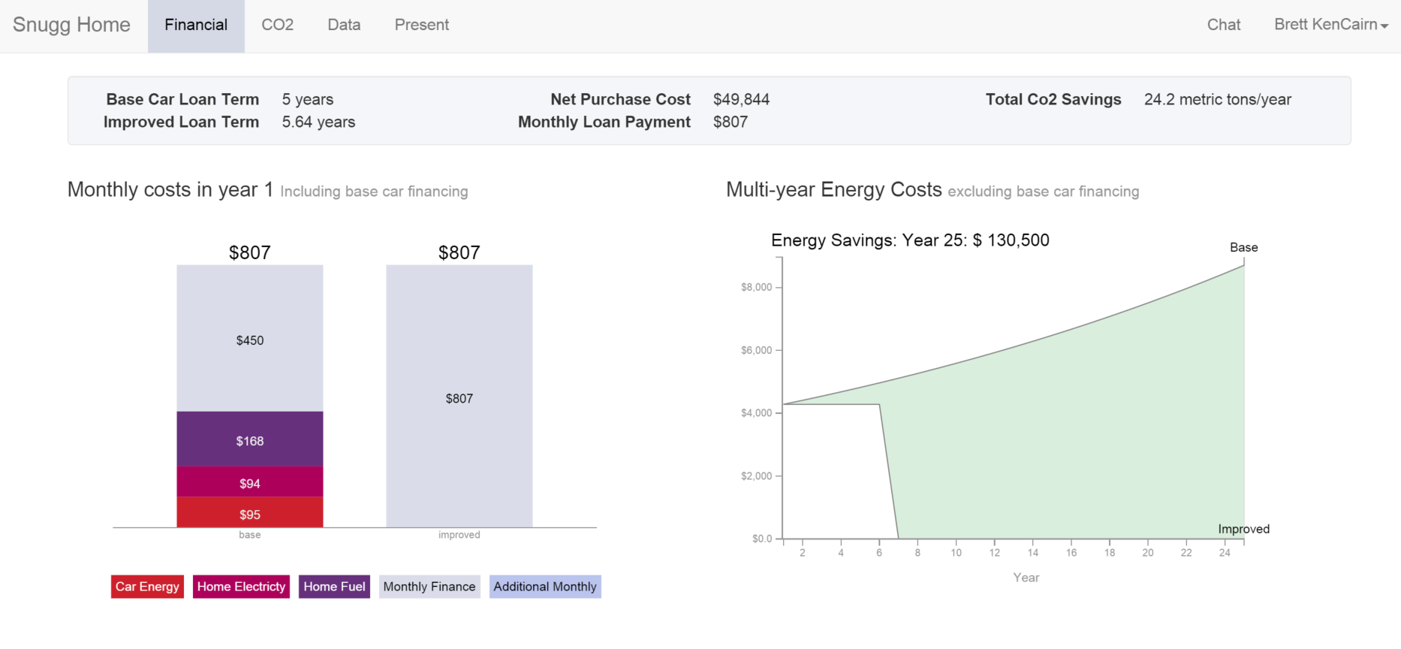
Story #1: Household Level Risk Management The Synergies of EV-PV-EE

Slide 13
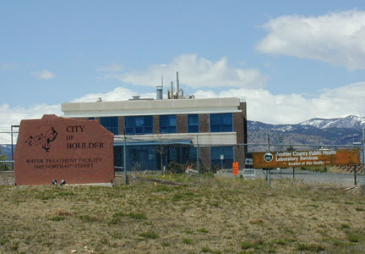
Story #2: Institutional/Commercial Scale Transition
City of Boulder 63rd St. Water Treatment Plant
Whole-systems approach with modular capability
Resilience/adaptation AND carbon reduction/energy system change

Slide 14
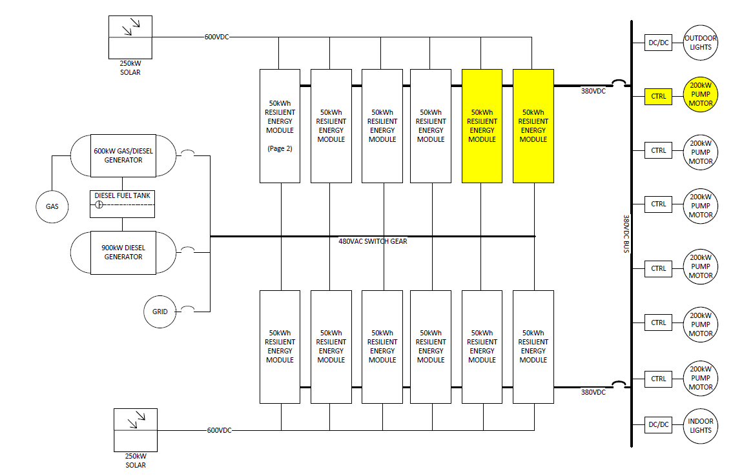
Disruptive Energy Systems
From: PosEn Energy Systems Development Team-2015

Slide 15
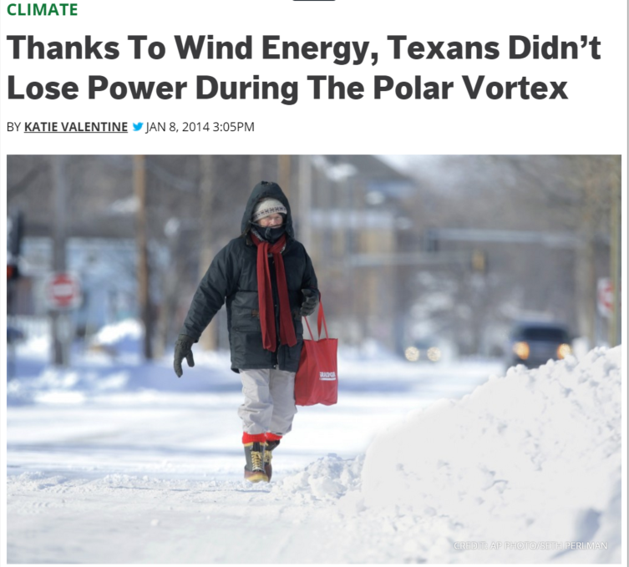
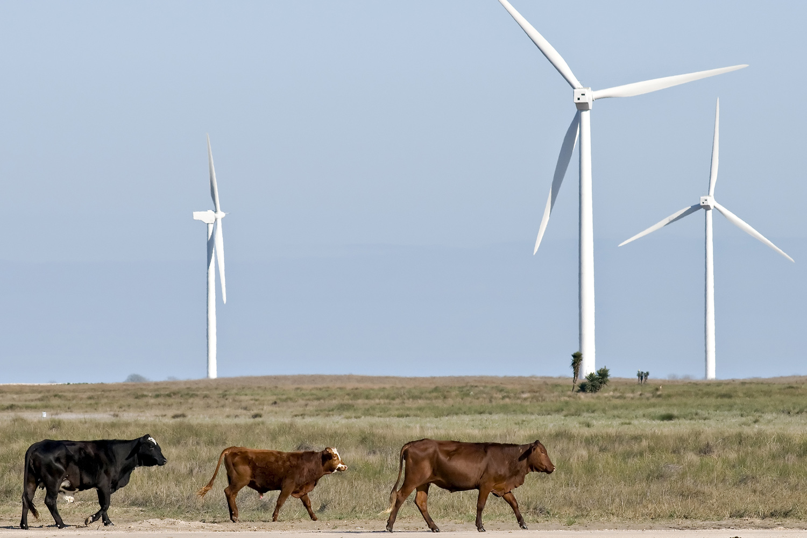
Story #3: Regional Scale Systems Change: Wind Energy Development—Land Based
Notes:
But this week’s Polar Vortex is putting the vulnerability of the U.S. energy grid in focus. On Tuesday, electricity demand in parts of the Southeast U.S. was the second-highest it’s been in winter since the 1920s, according to the Tennessee Valley Authority. Parts of Tennessee lost power during the night, and parts of South Carolina instituted rolling blackouts to manage the electricity demand. Earlier this week, 40,000 people in Indiana lost power, and people across the country were urged to conserve power so that the grid could deal with the spike in demand.
Severe weather is the number one cause of power outages in the U.S., meaning that as extreme events become more common, the U.S. power grid will be put more and more at risk. Between 2003 and 2012, extreme weather caused more than 675 power outages and cost the U.S. $18 billion to $33 billion per year, according to the President’s Council of Economic Advisers and the Department of Energy. According to the report, which was released in August, transmission line construction in the U.S. has slowed from 10,000 miles built per year in the late 1960s to just 1,000 miles per year in the mid-2000s — a slowdown that means about 70 percent of U.S. transmission lines and power transformers are over 25 years old. Massoud Amin, electrical engineering professor at the University of Minnesota, estimates that updating the country to Smart Grid technology would cost $21 billion per year for the next two decades, but would ultimately result in savings of savings of between $79 and $94 billion per year.

Slide 16
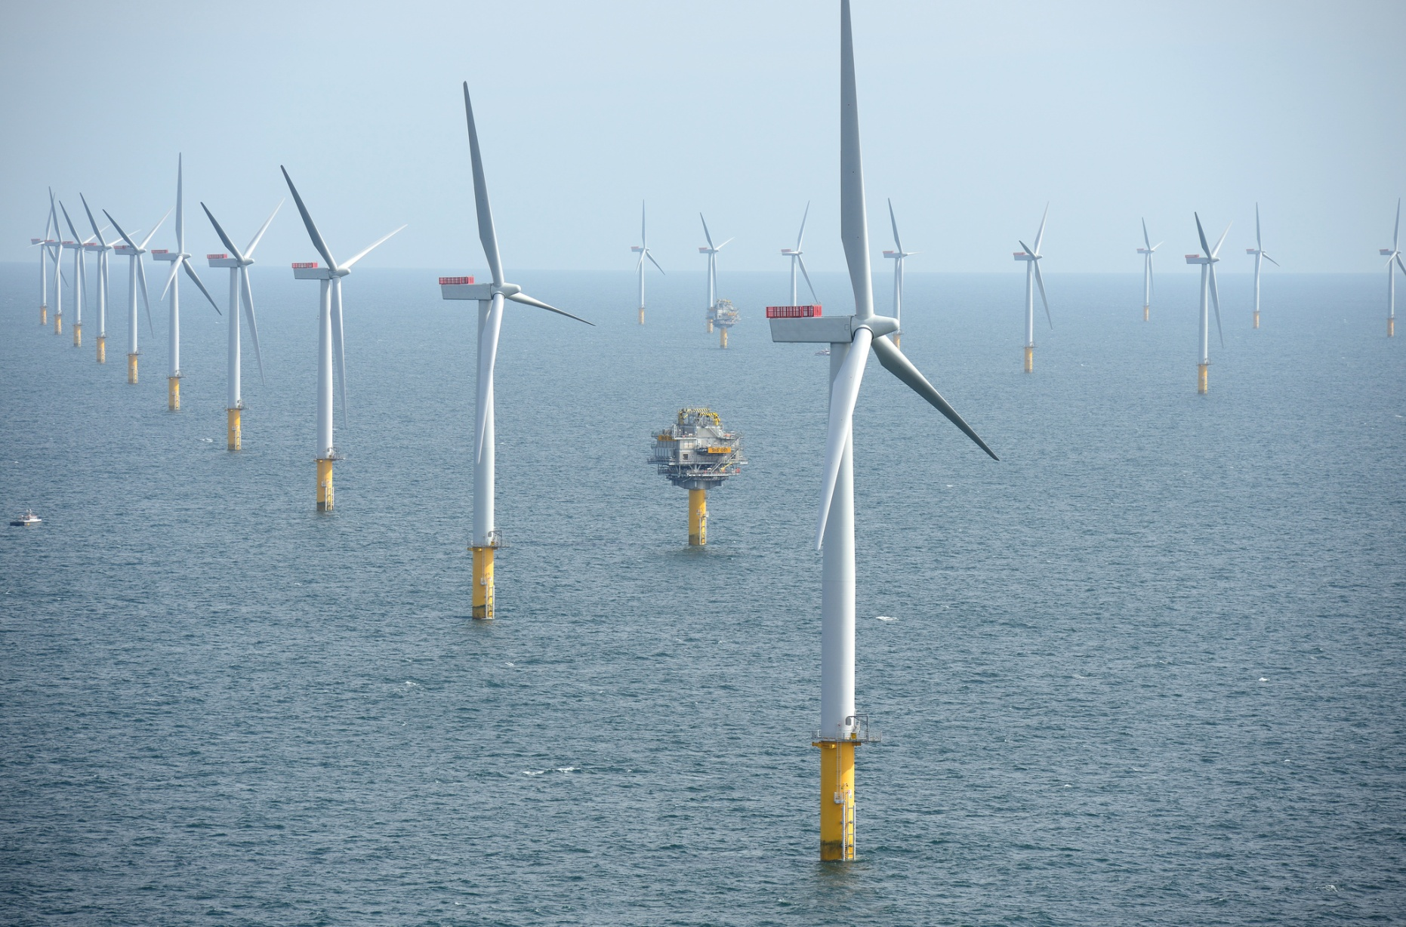
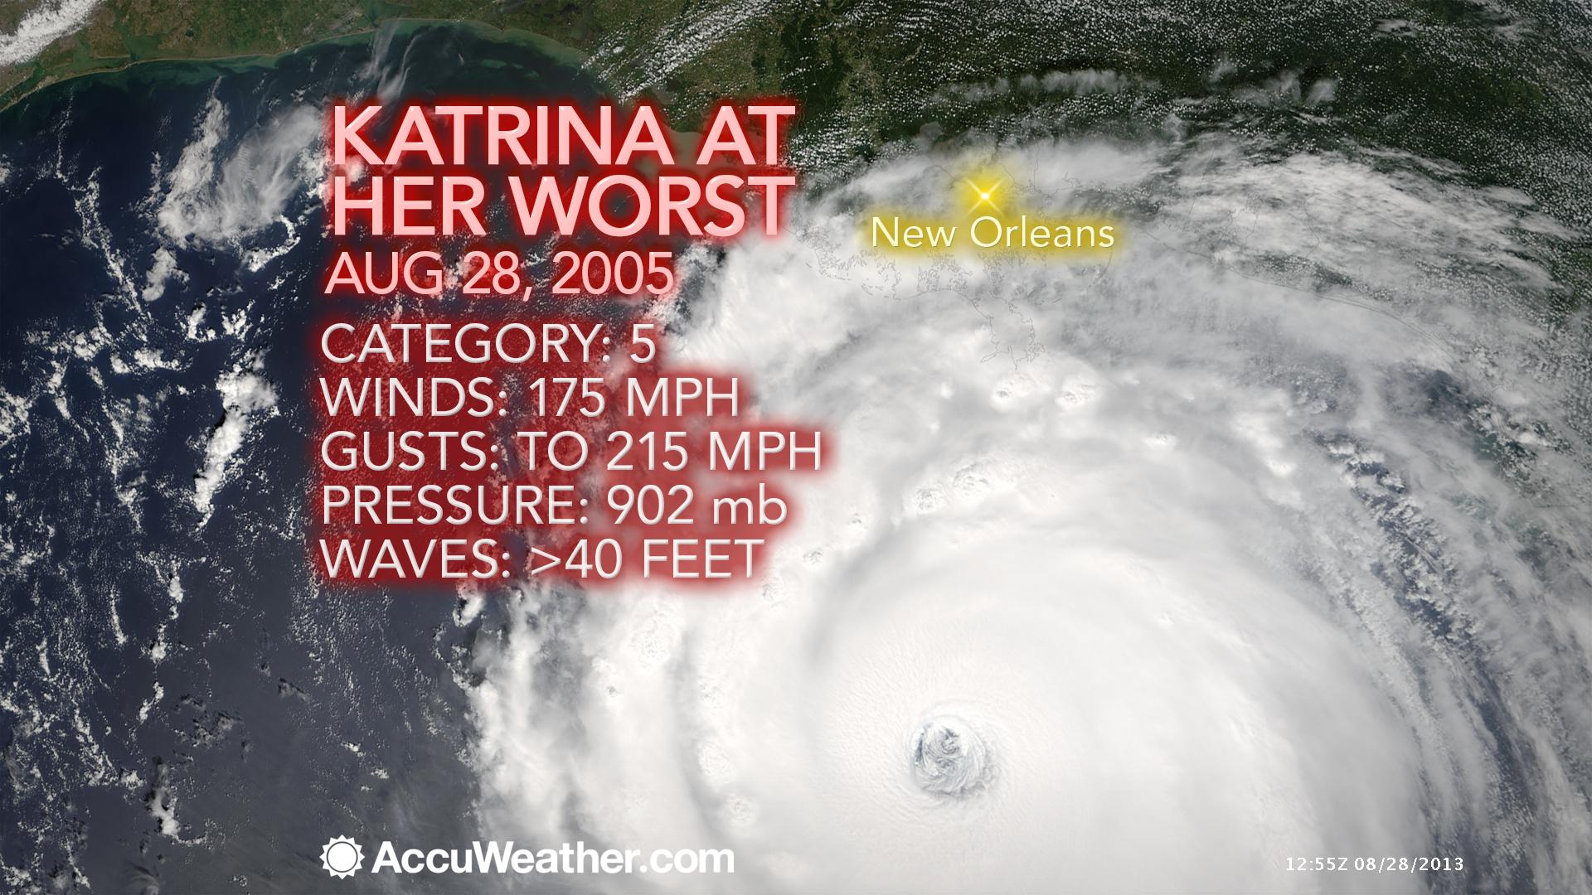
Wind Energy Development—Off Shore

Slide 17
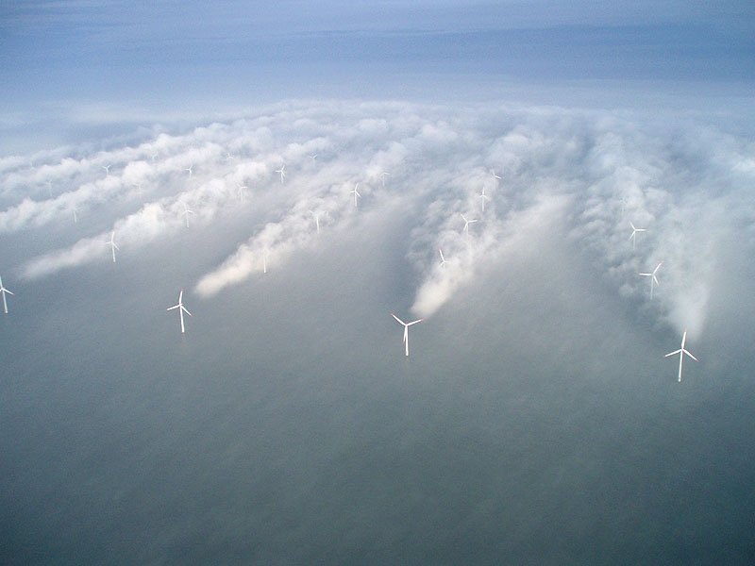

Slide 18
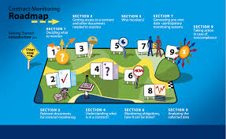
IV. How do we plan for Climate Change?
Its not about one grand plan:
Everyone needs a climate-energy transition plan!
One Community Climate Plan
50,000+ Energy Transition Roadmaps
and

Slide 19
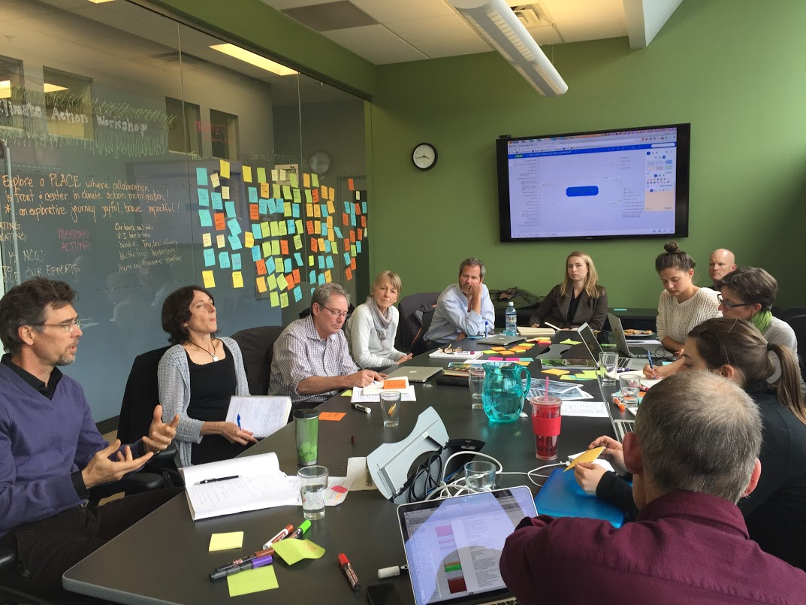
Collaboration: The Biggest Risk Reduction Factor

Slide 20
Lao Tzu Revisited: Maybe there is a marriage of yin (sustainability) & yang (change)

Slide 21
Thank You… for all YOU Are doing!

Slide 22
Climate Change on the Front Range

Slide 23
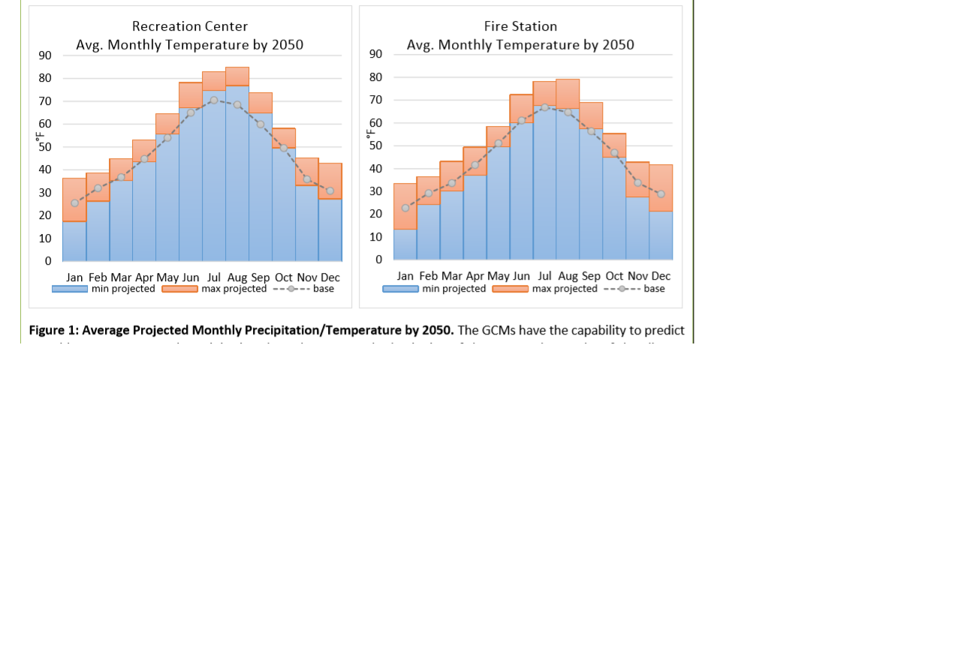
Boulder Climate Impacts:
Projected Potential Temperature Extreme @ 2050

